Slide 1
Part to Doc behaviors
Jeff Zemsky
October 24, 2012

Slide 2







Parts – pulling it all together
Part Attributes (metadata)
Number | 051000
Name | BRAKE CALIPER
Version | B.2
State | RELEASED
Weight | 8.7 kg
Material | Nodular Cast Iron
Usage
Parent
CAD Model
Requirements
Drawing
Viewable
Data Sheet
Changes
Test Plan
Analysis
Usage
Child 1
Usage
Child 2

Slide 3
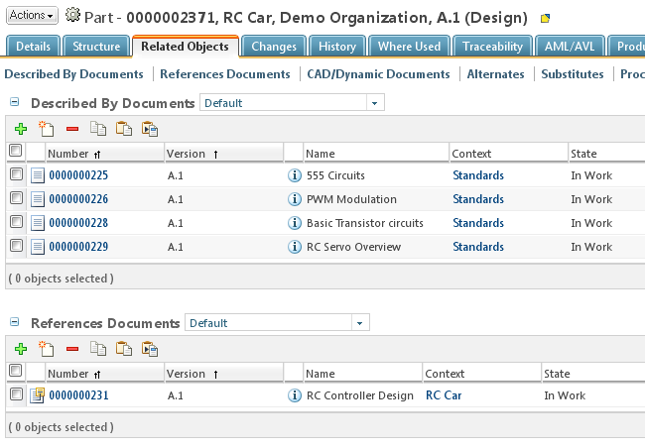

Part to Document Links
Version Specific Documentation
  Described By Documents
Version Independent Documentation
  References
Version-To-Version Links
Describes
A.2
A.1
A.2
A.3
B.1
A.1
Reference
Results can vary between this table and PSB. PSB uses the applied filter where table uses the Latest Released
A.1
A.2
A.3
B.1

Slide 4
Appendix A – Describes By behavior
1- Associate
2- iterate
5- iterate
Between part and document
  Type of link: WTPartDescribeLink
  Iteration to Iteration link
  New iteration of the part point to latest iteration of the document
  New iteration of the document point to latest iteration of the part
  History link point always to the latest iteration of the document before the part gets iterated.
  History link always point to the latest iteration of the part before the document gets iterated.
  Revise part copy forward the link to the latest iteration of the document
  Revise document does not copy forward the link
  Revise both document and part together, copy forward the link to the new version of the document.
  Save-As the part copy forward the link
  Copy document does not copy forward the link
A.1
A.2
A.3
A.4
1
2
4
6
3
5
A.1
A.2
A.3
A.4
A.5
3- iterate
4- iterate
7- iterate
Related document
Related part
B.1
6- Revise
B.1
8- Revise

Slide 5
Appendix B – References behavior
1- Associate
2- iterate
4- iterate
Between part and document
  Type of link: WTPartReferenceLink
  iteration to master link
  New iteration and version of the part always points to the document master.
    Link is copied forward
    Ability to navigate to the latest iteration of each version from there.
  New iteration of the document has no effect on the link. Config spec is used to display the linked parts.
    Latest is used in the case of Windchill PDM
    Released is used in the case of PDMLink
  Revise of the part copy forward the link to the the document master
  Revise of the document copy forward the link to the part version.
  Save-As the part copy forward the link to the document master
  Copy document does not copy forward the link
A.1
A.2
A.3
A.4
4
6
3
5
Master
A.1
A.2
A.3
A.4
3- iterate
5- iterate
6- iterate
References
Referenced by
B.1
7- Revise
B.1
8- Revise

