Slide 1
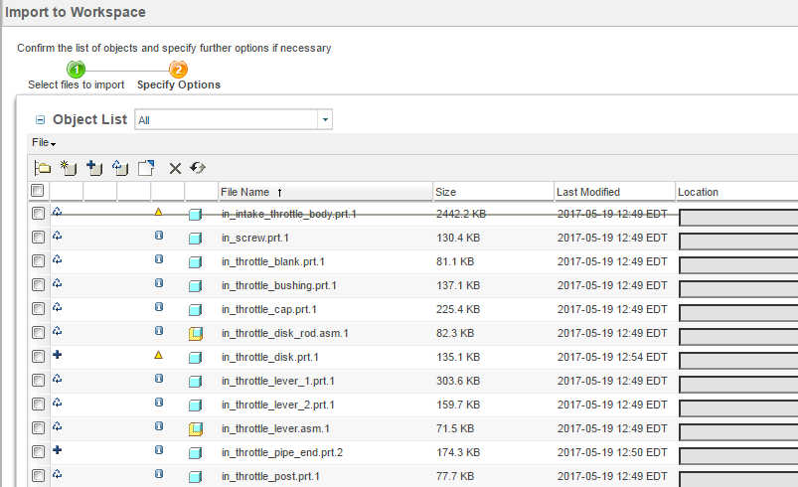
Import & Export enhancements for external collaboration with Creo data
11.0 M030 + Creo 4.0 M020
Creo data is exported from workspace
When the data is re-imported to workspace, do the smart id/version/modification check and indicates the status
: imported content is not modified, later version is saved in the server
Content is reused:
CAPABILITIES
Improve the efficiency of external collaboration workflow with traceability tool on workspace import
Provide granular status for objects upon import to workspace if the file name exists on Windchill server
The following info is provided at import page
  Version Compare
  Modification check
  Identity check
: The imported object is not modified and based on latest version
Content is reused:
: The same file name exist in the server; completely new file
Modified (user decide):
: The imported object is modified and based on latest version
Content is Modified:
Decrease time to incorporate changes into the overall process
Decrease redundant data in system by rejecting save of unchanged data
Strengthen collaboration strategy through traceability of exchanged data
BENEFITS

