Slide 1
Issue list ID 276
MAPSB: Multi select in Visualization using “box” does not select rows in structure

Slide 2
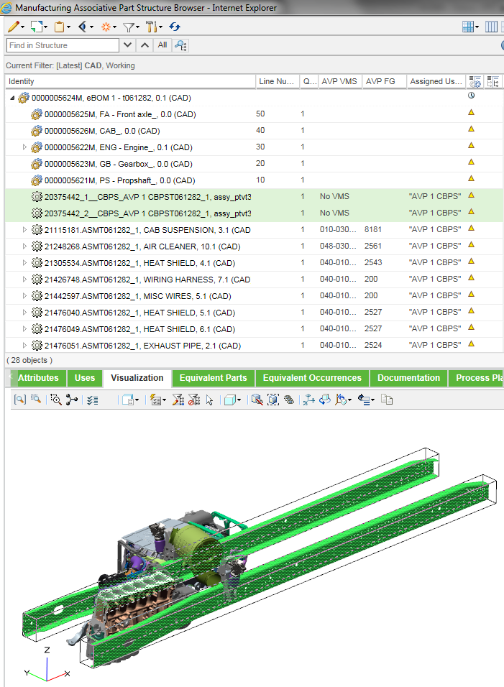




Multi select with Ctrl + Mouse
Rows in structure are selected

Slide 3
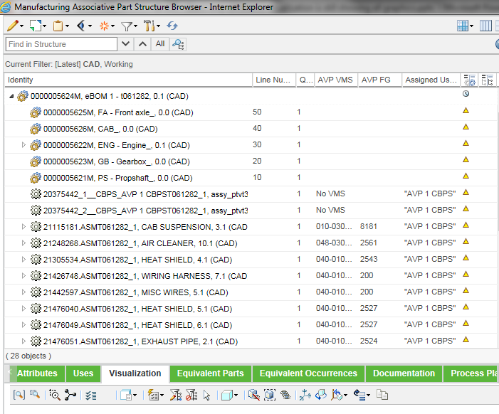

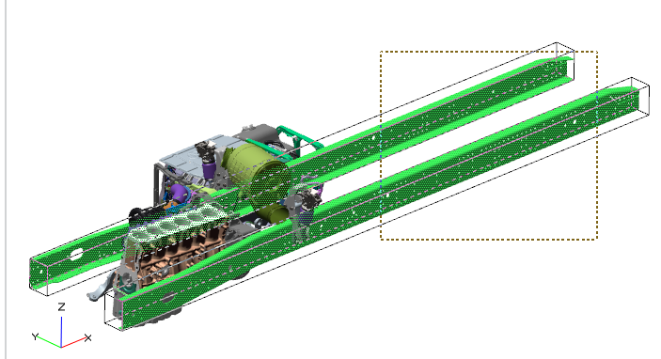
Multi select with Mouse ”boxing”
Rows in structure are not selected
Hard for user to pick part by part, much quicker to ”box” parts

