Slide 1
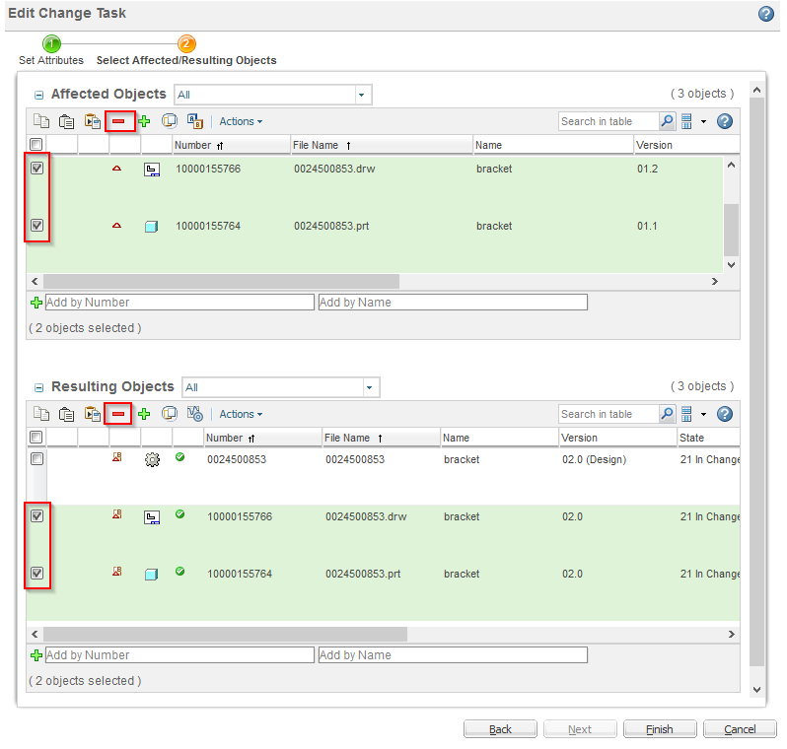

As is (Windchill 11)
Suggestion
3
Objects
Resulting
Move „resulting objects“ area to a separate tab

