Slide 1
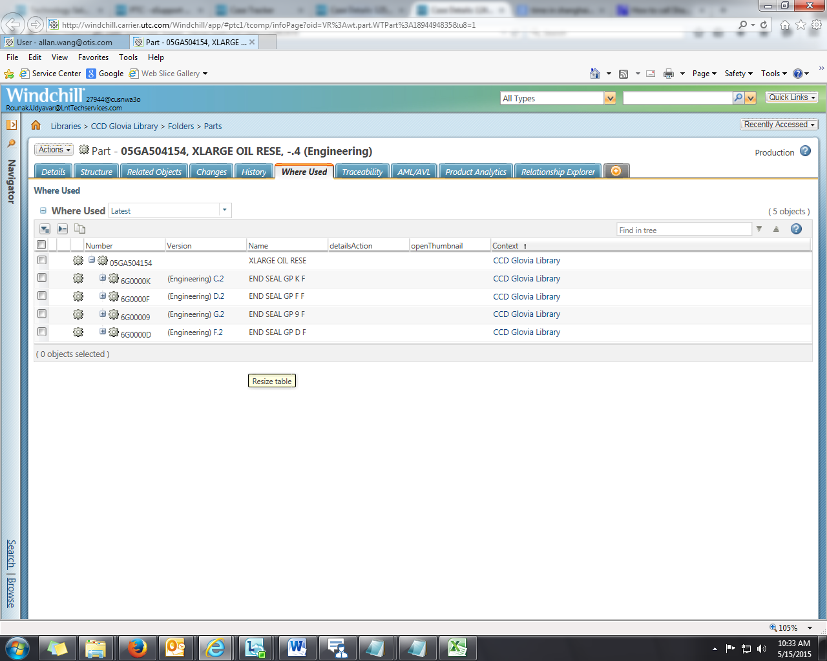
Product Ideas @ PTC Community
State
In the “Where Used” Tab in WTPart we require the following:
1. Require an extra column which would specify the current State in which the WTObject is in.
2. Require an option by which the data can be exported into an excel file.

