Slide 1
Part Configurations vs. Baselines
Per Ekholm
PDS Vision

Slide 2
Background / Needs
Customers need a configuration object to freeze a product structure in a certain time to capture
  Prototype configuration
  As Designed Configuration
  (As Planned Configuration)
The Customer might be working in parallel against multiple configurations.
The configuration shall capture the complete structure including related data.
It shall be possible to release the configuration by a workflow

Slide 3
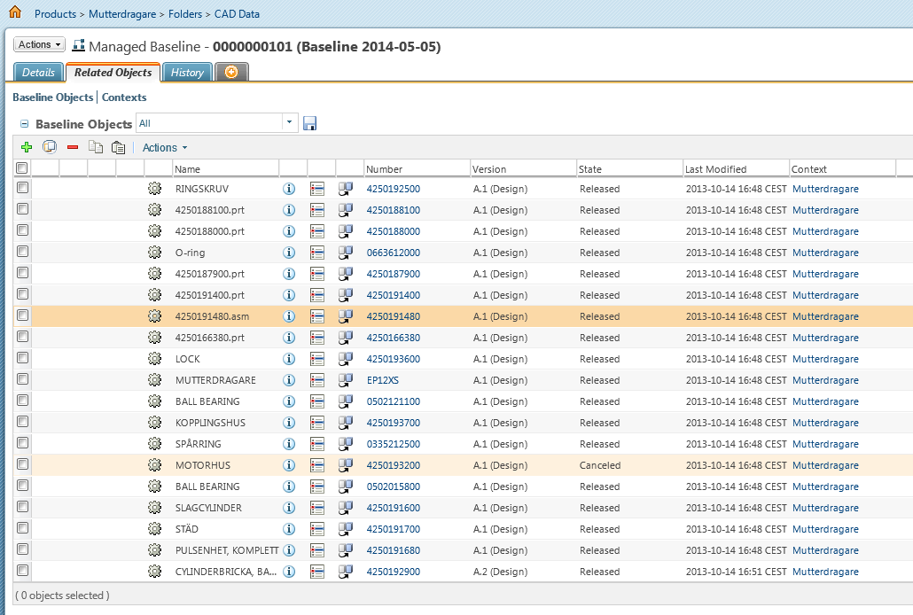
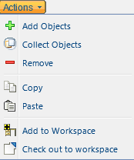
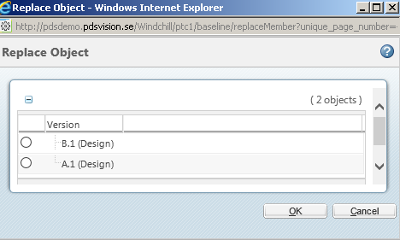
Baseline
Act as a box where objects can be added.
The baseline has no structure its self, but can be used as a config spec/filter to configure a structure.
CAUTION: If not all parts were added to the baseline, the structure will show master or latest part version.

Slide 4
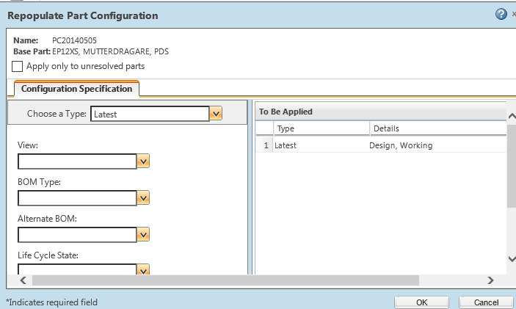
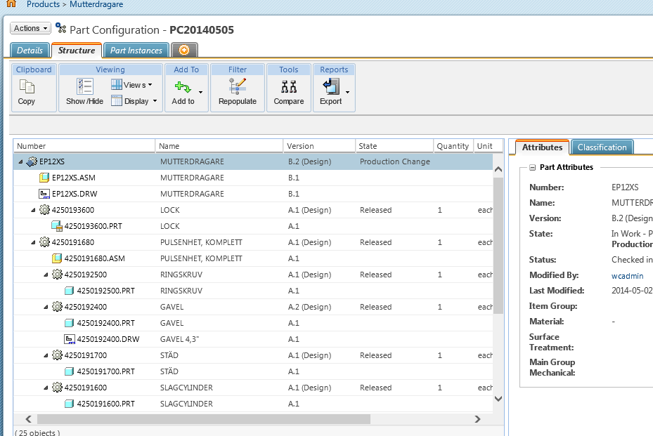
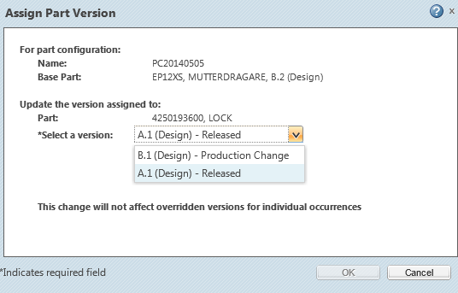
Part Configuration
A part Configuration act as taking a picture of the structure .
The structure can be repopulated or each part version can be updated manually.
No CAD integration (Add to workspace) actions.
Part Instances can be generated from a part configuration representing an As Build configuration.

Slide 5
Customer feedback
Most Customers prefer to use part configurations before baselines because:
  Easy to capture
  Easy to search and directly receive the structure
  Easy to repopulate or assign new part versions
What customers are missing
  Add to workspace / open in Creo
  Visualization tab in the structure view
  Link document to the part configuration (as for part instances)
  Would be good if part configurations was versioned to revise a As Designed configuration and keep the history instead of create a new configuration.

Slide 6
Using effectivity
Effectivity has not been adopted by any customer because:
  Effectivity is primary a production planning tool, and are not addressing the needs of frozen configurations.
  Effectivity is hard to use, even if it has been easier by set effectivity traversed in the structure.
  Correct trace codes has to be set for each usage link
  Effectivity tools is only available from ECN tasks

