Slide 1
NEW IDEA
When we open the instance from Family table, only connector has moved but Cable location does not move.
CURRENT SCENARIO
When we open the Hanress instance from Family table, the Cable location should move along with the connector
Expected behaviour
Find the following examples in below slides and attached video

Slide 2
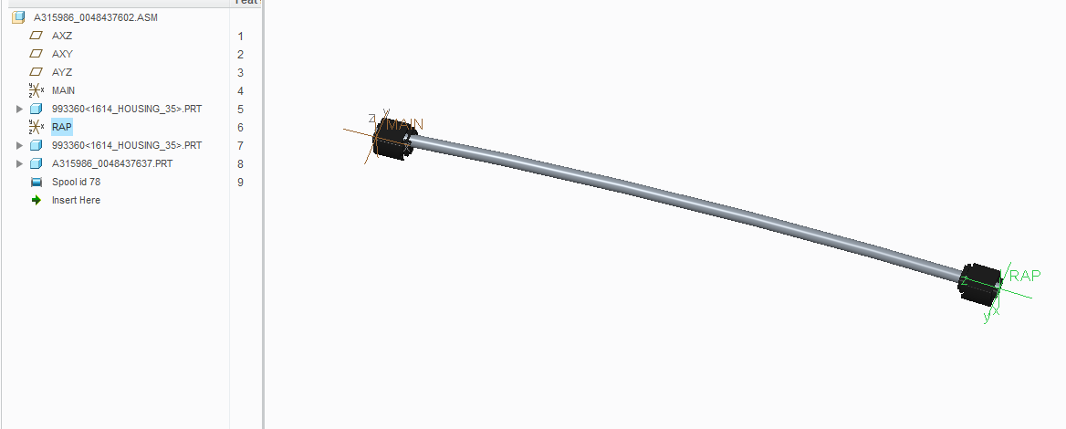
Assembly Structure
MAIN
X= 500mm
CON1
CON2
RAP
CON1 IS ASSEMLED WITH MAIN C0-ORODINATE SYSTEM
RAP CO-ORDINATE CREATED WITH RESPECT TO MAIN (X - 500mm)
CON2 ASSEBLED WITH RAP CO-ORDINATE SYSTEM

Slide 3
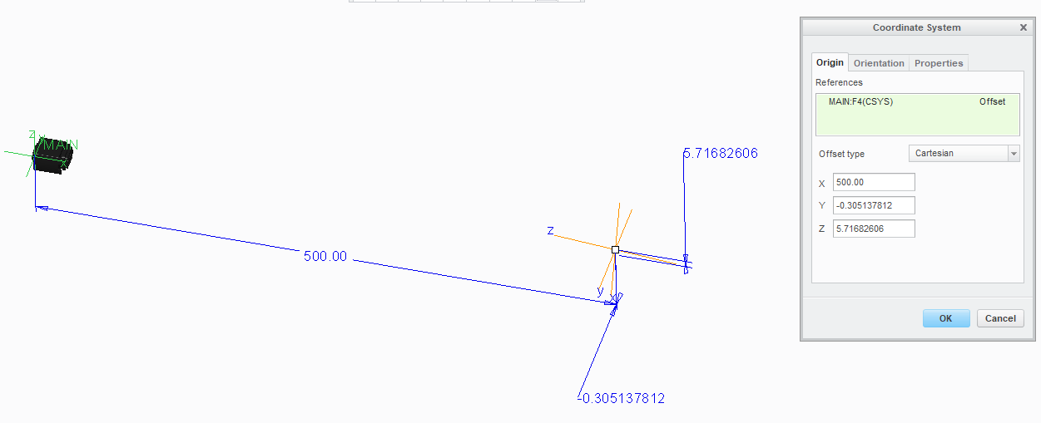
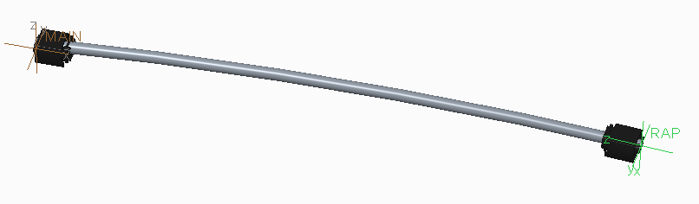
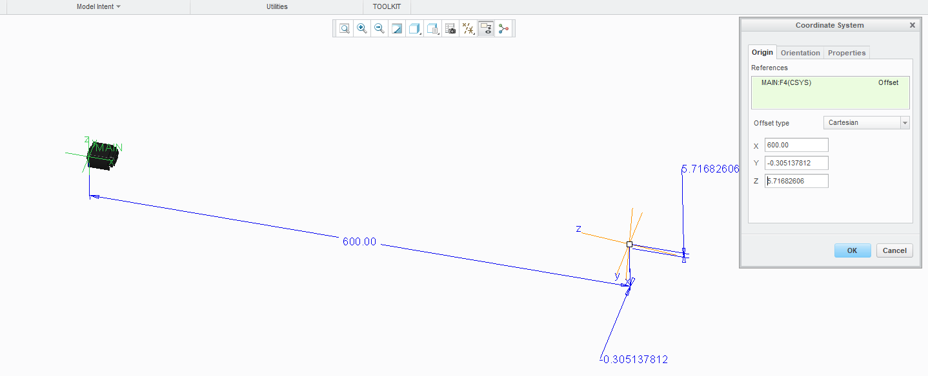
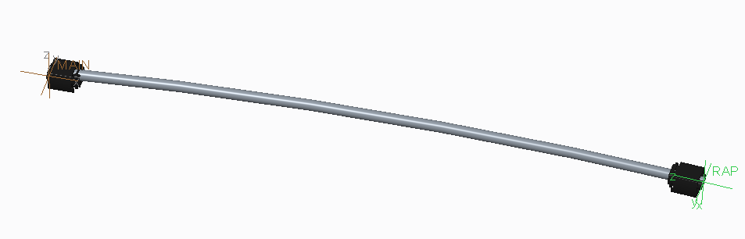
Generic Assembly
When we change RAP co-ordinate X-distance, Connector and Cable location also move with respect to
the x-distance

Slide 4
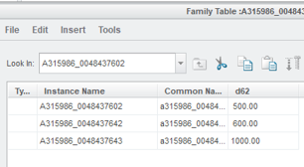
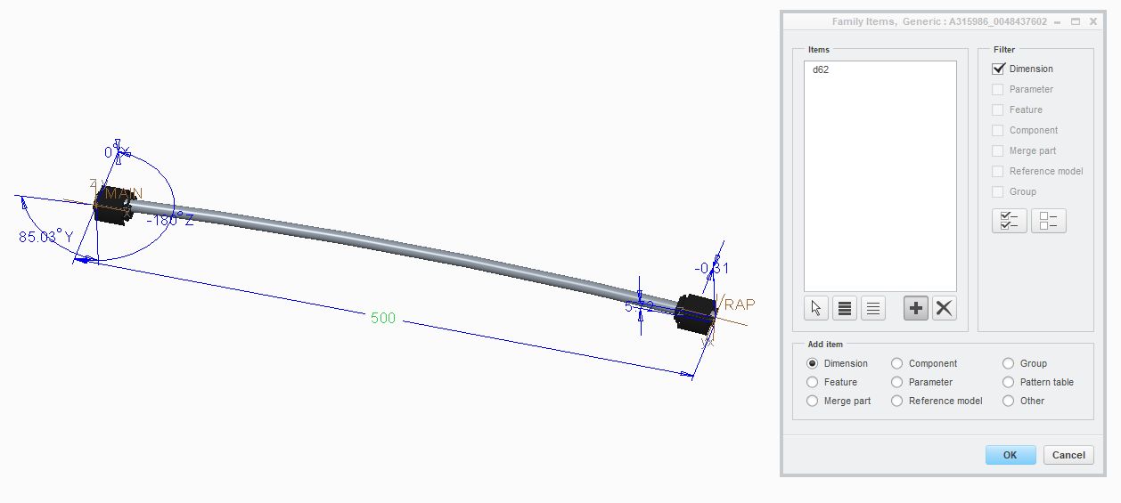
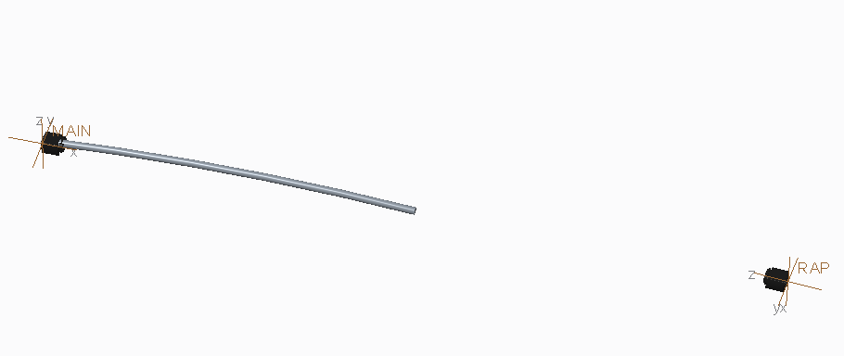
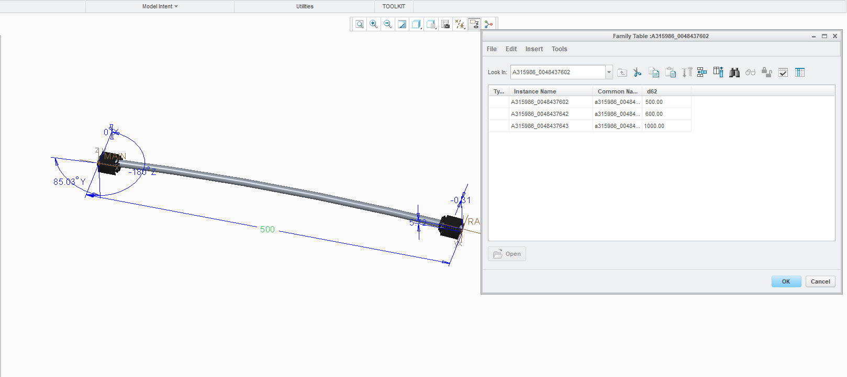
Family table instance parameter does not work
1. Added the Dimension in the Family table and given the variable dimension in the instance
2.When we open the instance, only connector has moved but Cable location does not move.

