Slide 1
An Admin’s guide to License Management
David Haigh
LLNL-PRES-775233
This work was performed under the auspices of the U.S. Department
of Energy by Lawrence Livermore National Laboratory under Contract
DE-AC52-07NA27344. Lawrence Livermore National Security, LLC
Boston PTC Live 2014
Notes:
As always, there is lots to cover and not much time.

Slide 2

Help!... I’m spending too much!
Notes:
Have you ever looked at your maintenance bill and said I’m spending way too much?

Slide 3
Help!... I’m spending too much!
It’s all about the money!
Notes:
This talk is all about saving you money.

Slide 4
Help!... I’m spending too much!
It’s all about the money!
Save money by:
Managing licenses availability
Notes:
There are three basic ways to save money.
First make sure the licenses you have purchased are available when people need them.

Slide 5
Help!... I’m spending too much!
It’s all about the money!
Save money by:
Managing licenses availability
Properly allocating licenses
Notes:
Next is to manage what license are available to specific individuals.

Slide 6
Help!... I’m spending too much!
It’s all about the money!
Save money by:
Managing licenses availability
Properly allocating licenses
Knowing your usage
Notes:
Finally you need to know how many licenses are really being used.

Slide 7
Help!... I’m spending too much!
It’s all about the money!
Save money by:
Managing licenses availability
Properly allocating licenses
Knowing your usage
Topics
License Management
What’s with the new Flexnet software?
Notes:
After going over License Management we’ll spend a little time looking at the new license manager that ships with Creo.

Slide 8
License Management
Users can choose an appropriate license
Notes:
Here’s what I think License Management is: This is the same three points just stated differently.
First, making sure your license configurations allow users to choose the appropriate license when needed.

Slide 9
License Management
Users can choose an appropriate license
Specific folks can access specific licenses
Notes:
Making sure the correct individuals can access the license they need.

Slide 10
License Management
Users can choose an appropriate license
Specific folks can access specific licenses
Ensure you have enough licenses
Notes:
Making sure you have enough licenses, without going overboard.

Slide 11
License Management
Users can choose an appropriate license
Specific folks can access specific licenses
Ensure you have enough licenses
Must understand:
License types and how to configure them
Notes:
The first item requires understanding the license types and how to configure them.

Slide 12
License Management
Users can choose an appropriate license
Specific folks can access specific licenses
Ensure you have enough licenses
Must understand:
License types and how to configure them
License options file
Notes:
The second item requires understanding the license options file.

Slide 13
License Management
Users can choose an appropriate license
Specific folks can access specific licenses
Ensure you have enough licenses
Must understand:
License types and how to configure them
License options file
How to track usage
Notes:
And the last item requires knowing how many of which licenses are being used.

Slide 14


License Types
Creo comes in different offerings
$$ $$$$
Notes:
Creo comes in different flavors from basic to all the topping.
If you have a large organization, it’s doubtful that everyone needs the banana split with all the toppings. This can be a useful way of reducing your cost.

Slide 15
License Types
Creo comes in different offerings
$$ $$$$
Optional Components
Notes:
There are many optional components.

Slide 16
License Types
Creo comes in different offerings
$$ $$$$
Optional Components
Floating Options
Startup Extensions
Notes:
These are licensed in one of two ways: Startup Extensions, or Floating Options

Slide 17
License Types
Creo comes in different offerings
$$ $$$$
Optional Components
Floating Options - Used when you access it
Startup Extensions
Notes:
With at least one exception, Floating Options can be added to your Creo session after you start the software. The license is only used when you access it.

Slide 18
License Types
Creo comes in different offerings
$$ $$$$
Optional Components
Floating Options - Used when you access it
Startup Extensions - Used when you start Creo
Notes:
Startup options on the other hand must be configured during the install. These licenses are used as soon as you start Creo.

Slide 19
License Types
Creo comes in different offerings
$$ $$$$
Optional Components
Floating Options - Used when you access it
Startup Extensions - Used when you start Creo - these float also
Notes:
It’s a common misconception that you can’t float startup options between users. That’s not true. You just can’t add the option to a running session of Creo for which it wasn’t already configured.

Slide 20
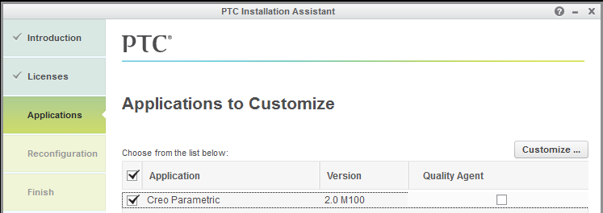
Command Configuration
Notes:
In order to create a command configuration, during the software install, you need to pick “Customize” button

Slide 21
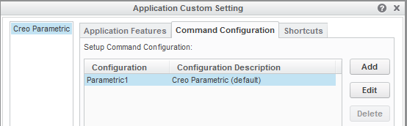
Command Configuration
Notes:
and then pick the “Command Configuration” tab
By default when you open up the configuration, you will see “Parametric1”, with the description “Creo Parametric (default)”

Slide 22
Command Configuration
Notes:
Picking the Edit button will let use modify the licenses for this configuration.

Slide 23
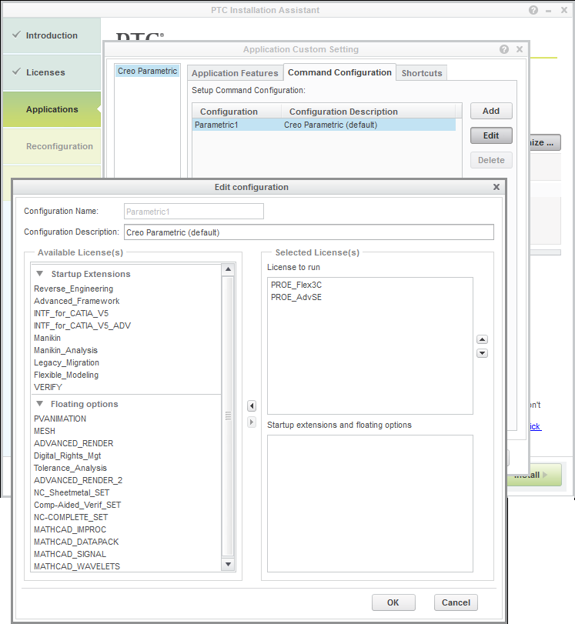
Command Configuration
Only active on creation
Startup menu name
Notes:
This is the Command Configuration Window. The top two lines are the labels we saw in the previous window.
“Parametric1” & “Creo Parametric (default)”

Slide 24
Command Configuration
Notes:
On the right is a section labeled Selected Licenses

Slide 25
Command Configuration
Notes:
The top part lists the licenses to run

Slide 26
Command Configuration
Notes:
the bottom part list the extensions.

Slide 27
Command Configuration
Notes:
I have two flavors of Creo that are available. Advanced SE, and Flex 3C.

Slide 28
Command Configuration
License run order
If first set is used up or restricted, rolls to next set
Notes:
When Creo starts, it will try the first item in this list. If the licenses are used up, or there is a restriction, it will try the next one.

Slide 29
Command Configuration
License run order
If first set is used up or restricted, rolls to next set
Change the run order
Notes:
I always change this order, I put the high end license first.
Select a license, then use the arrows to move it up or down.

Slide 30
Command Configuration
These licenses are used when Creo starts up
Notes:
The bottom window shows what additional licenses will be activated when Creo starts.

Slide 31
Command Configuration
These licenses are used when Creo starts up
Notes:
You populate this from the “Available Licenses” in the left hand window.
Expanding the floating options allows you to select those also.
You move the options by hi-liting them and using the arrows.

Slide 32
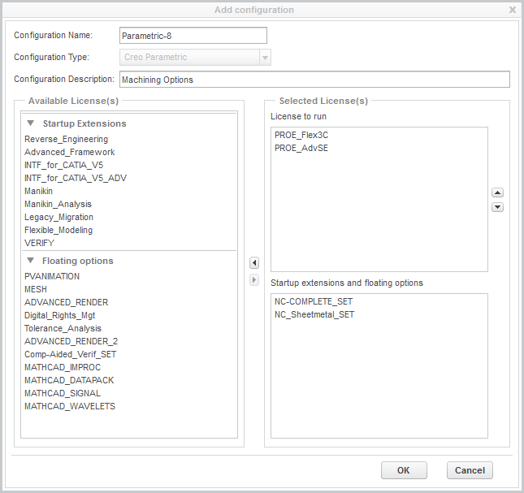
Command Configuration
These Floating Options have to be configured
Notes:
Normally you shouldn’t have to add floating options. This isn’t true for the “Complete Machining Set”.
If the Basic Machining option that comes with all Creo installations gets loaded, you’ll never be able to access the menus for the “Complete Machining Set”.
This Has to be configured it as a selected license.
So this floating option behaves more like a startup option.

Slide 33
Command Configuration
Startup Extensions are unavailable if they are not configured into a command
Floating Options are used up if they are configured into a command
Notes:
Startup Extensions are unavailable if they are not configured into a command
If Floating options are added to a command, they are used when Creo starts.
As you can see we have some high dollar options. When I took over managing our ProE installation, I noticed we had these options, but none had been configured.
A complete waste of money.
Worse yet, floating options like Advanced Render, had been added to the license. We have two of these. So guess what, the first two users got those licenses.
So let me show you what our previous Admin didn’t understand, and honestly, I don’t think he’s alone.

Slide 34
Command Configuration
You can add additional startup commands
each can have their own licenses configuration
Notes:
In the Command Configuration tab, notice on the right there are three buttons, Add, Edit, and Delete.
You can add multiple configurations here

Slide 35
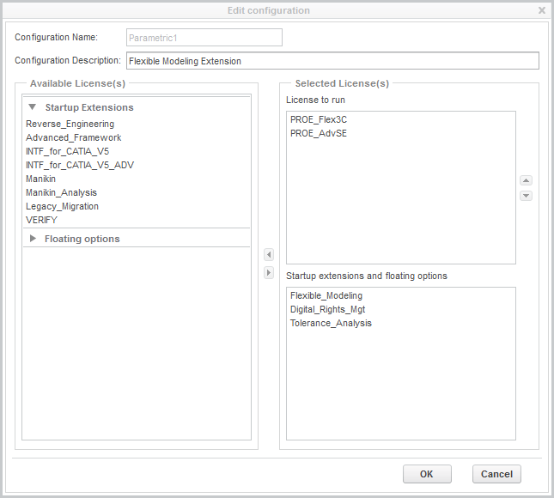
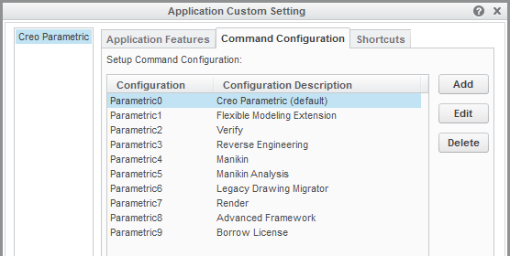
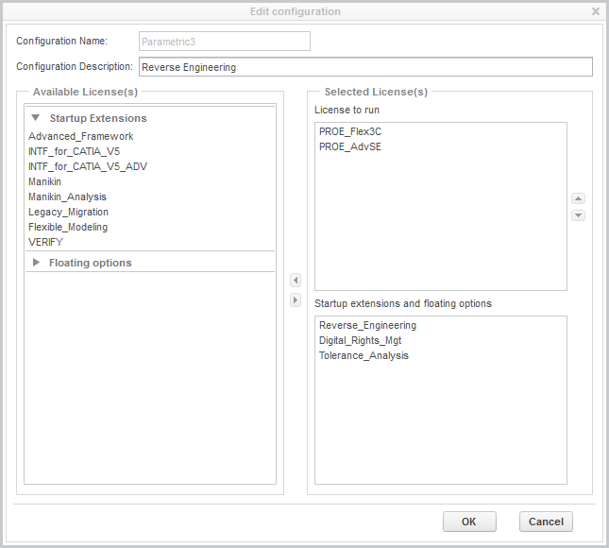
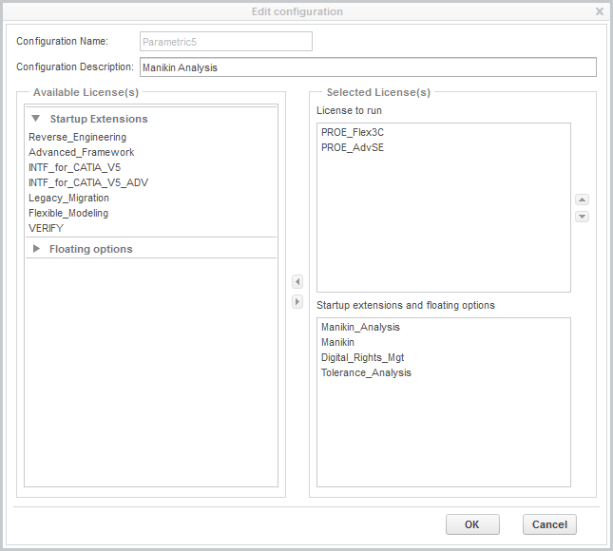
Command Configuration
Notes:
each one can have a different set of licenses assigned.

Slide 36
Command Configuration
Notes:
I think it’s important to understand what’s going on under the hood when you create a command configuration.

Slide 37
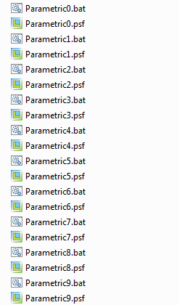
Command Configuration
Files created in parametric/bin folder
Notes:
Down in the load point for Creo, in the Parametric/bin folder a .bat and a .psf file is created for each configuration you make.

Slide 38
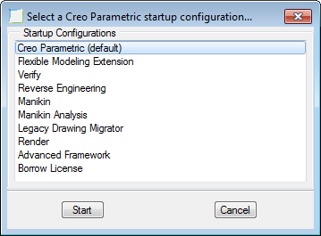
Command Configuration
Files created in parametric/bin folder
Notes:
When a user starts the software, Creo sees the multiple configurations and presents the user with a menu of choices.
The names come from the Command Description
The default configuration should be first one in the list.
With the advent of Creo, PTC changed how this list was ordered.

Slide 39
Menu Order Weirdness
Creo 2.0 f000 – m090
Reverse order of creation
Order of Description column
Default choice
Should be 1st
Notes:
It was based on the reverse order of creation of the commands. Which was pretty inconvenient.
If you wanted to change one configuration you had to change them all and do it in a specific order.

Slide 40
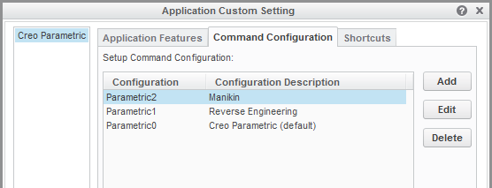
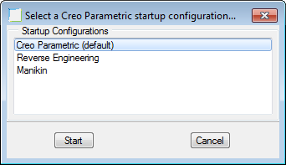
Menu Order Weirdness
Creo 2.0 f000 – m090
Creo 2.0 m100 & all ProE
Reverse order of creation
Order of Description column
Alphabetical order of
Configuration name
Default choice
Should be 1st
Notes:
Now in m100 & 110, the order is now back to the old ProE default,
it’s based on the configuration name.

Slide 41
Command Configuration
The Good:
Buy few copies of expensive options and float them to any user
Notes:
The beauty of using multiple configurations is you can buy one copy of an expensive rarely used license, and let anyone in your company use it.

Slide 42
Command Configuration
The Good:
Buy few copies of expensive options and float them to any user
All clients get the same licenses
Notes:
Also, all machines get the same install.
One added benefit is every the user starts Creo, they get a reminder of the licenses available.

Slide 43
Command Configuration
The Good:
Buy few copies of expensive options and float them to any user
All clients get the same licenses
The Bad:
Most users are not used to selecting the license at run time
Notes:
Most users are not used to picking the license they want when they start Creo.

Slide 44
Command Configuration
The Good:
Buy few copies of expensive options and float them to any user
All clients get the same licenses
The Bad:
Most users are not used to selecting the license at run time
You have to exit and restart to get a license you might need
Notes:
Also if you want an option that your current session of Creo doesn’t have, you have to exit Creo and start again to pick the license you want.

Slide 45
Command Configuration
The Ugly:
Configure unique licenses on client machines
Notes:
Even with the downsides, this is far better than going to a users computer and customizing their installation to give them access to some option.
If you do that, then you are going to have multiple computers with different configurations.

Slide 46


Command Configuration
The Ugly:
Configure unique licenses on client machines
Expert Framework
Manikin
Notes:
Now you have to keep track that Barny has Expert Framework, and Fred has Manikin.

Slide 47

Command Configuration
The Ugly:
Configure unique licenses on client machines
Expert Framework
Manikin
Giving framework to Wilma requires
reconfiguring two client machines
Notes:
Let’s now suppose you want to remove Framework from Barney and give it to Wilma.
You now have to reconfigure Creo on both machines.
That’s license mismanagement. It’s a time bandit, keeping you from other useful things you could be doing. I don’t want that job!
Now of course, some of you may be thinking, but I want to limit some options to an individual or group. You don’t want a person doing drafting, grabbing one of my few Complete Machining Option.
That’s where my second point come in.

Slide 48
Reserving Licenses
Notes:
Reserving Licenses
Making sure the correct individuals can access the licenses they need, is done with the PTC options file.
The best way to make sure certain people can get the licenses they need, is to “reserve” licenses for them.

Slide 49
Reserving Licenses
Your License File
#################### FLOATING License ####################
# Serviceable = Creo Enterprise SE (formerly Pro/ENGINEER)
# Feature Name = PROE_Flex3C
# Feature Version = 33.0
######### Super Bundle 10114 Instance ##########
# Serviceable = Complete Machining Option
# Feature Name = 10114
# Feature Version = 33.0
Notes:
But before we can reserve licenses, we need to know what to reserve, and the version of that item.
So if we look at the feature information in your license file you’ll see this

Slide 50
Reserving Licenses
Your License File
#################### FLOATING License ####################
# Serviceable = Creo Enterprise SE (formerly Pro/ENGINEER)
# Feature Name = PROE_Flex3C
# Feature Version = 33.0
######### Super Bundle 10114 Instance ##########
# Serviceable = Complete Machining Option
# Feature Name = 10114
# Feature Version = 33.0
Notes:
you will find the name of the feature here

Slide 51
Reserving Licenses
Your License File
#################### FLOATING License ####################
# Serviceable = Creo Enterprise SE (formerly Pro/ENGINEER)
# Feature Name = PROE_Flex3C
# Feature Version = 33.0
######### Super Bundle 10114 Instance ##########
# Serviceable = Complete Machining Option
# Feature Name = 10114
# Feature Version = 33.0
Notes:
and the version of the feature is here.

Slide 52
Reserving Licenses
Your License File
The version changes with each release of Creo
#################### FLOATING License ####################
# Serviceable = Creo Enterprise SE (formerly Pro/ENGINEER)
# Feature Name = PROE_Flex3C
# Feature Version = 33.0
######### Super Bundle 10114 Instance ##########
# Serviceable = Complete Machining Option
# Feature Name = 10114
# Feature Version = 33.0
Notes:
Just a warning, the version changes with each release of the software. So when you move from Creo 2 to Creo 3, this version is going to change.
Likewise if move up from Advanced SE to Flex 3C, the feature name will change also.

Slide 53
Reserving Licenses
Your users:
Need the active directory username for each user
Notes:
Once you know what it is you want to reserve, we need to know who to reserve it for.
What you need are the Active Directory usernames.
Even if it's only one individual, I think it's always best to create a group for them.

Slide 54
Reserving Licenses
Your users:
The ptc.opt file
Need the active directory username for each user
Located in:
C:\Program Files\PTC\FLEXnet Admin License Server\licensing
Notes:
Now that you have all that information, We are ready to set up the ptc.opt file
In the licensing folder you’re going to find an existing ptc.opt file.

Slide 55
Reserving Licenses
Your users:
The ptc.opt file
Need the active directory username for each user
Located in:
C:\Program Files\PTC\FLEXnet Admin License Server\licensing
By default has two lines:
REPORTLOG +"C:\Program Files\PTC\FLEXnet Admin License Server\logs\ptcreport.log"
TIMEOUTALL 7200
Notes:
By default it has two lines in it.

Slide 56
Reserving Licenses
Creating Groups:
GROUP flintstone
Group name
Notes:
To define a group you enter GROUP,
And the name you want to give the group.
For example fintstone

Slide 57
Reserving Licenses
Creating Groups:
GROUP flintstone fred wilma pebbles dino
Group name
Group members
Notes:
And then add the members of the group.

Slide 58
Reserving Licenses
Creating Groups:
Another group:
GROUP flintstone fred wilma pebbles dino
Group name
Group members
GROUP rubble barney betty bammbamm
Notes:
You can create as many groups as you want.
Here’s one for the rubble’s

Slide 59
Reserving Licenses
Creating Groups:
Another group:
Reserve Licenses for a group:
GROUP flintstone fred wilma pebbles dino
Group name
Group members
GROUP rubble barney betty bammbamm
RESERVE 4 PROE_Flex3c:VERSION=33.0 GROUP flintstone
RESERVE 3 PROE_Flex3c:VERSION=33.0 GROUP rubble
Notes:
After defining your groups, you can use the group name when reserveing licenses.
Flintstone has 4 licenses reserved
Rubble has 3 licenses

Slide 60
Reserving Licenses
Creating Groups:
Another group:
Reserve Licenses for a group:
GROUP flintstone fred wilma pebbles dino
Group name
Group members
GROUP rubble barney betty bammbamm
RESERVE 4 PROE_Flex3c:VERSION=33.0 GROUP flintstone
RESERVE 3 PROE_Flex3c:VERSION=33.0 GROUP rubble
Can be any option or Creo flavor
ProE_AdvSE – Foundation Creo
10114 – Complete Machining Set
Notes:
You can reserve floating options, startup options, or any flavor of Creo.

Slide 61
Reserving Licenses
ptcstatus.bat output:
PROE_Flex3C 3 7
^(fred@coaststarlight) PROE_Flex3C stonequarry 7788 3750
(barney@southwestchief) PROE_Flex3C stonequarry 7788 3472
(betty@californiazephyer) PROE_Flex3C stonequarry 7788 4837
(flintstone@) PROE_Flex3C stonequarry 7788 0
(flintstone@) PROE_Flex3C stonequarry 7788 0
(flintstone@) PROE_Flex3C stonequarry 7788 0
(rubble@) PROE_Flex3C stonequarry 7788 0
Reserved, in use
Reserved, not in use
Notes:
After the license server has reread the license, you should see something like this in the ptcstatus output.
If the license is in use you’ll see the username & client.
Reserved licenses will just show the group name.

Slide 62
Reserving Licenses
ptcstatus.bat output:
PROE_Flex3C 3 7
^(fred@coaststarlight) PROE_Flex3C stonequarry 7788 3750
(barney@southwestchief) PROE_Flex3C stonequarry 7788 3472
(betty@californiazephyer) PROE_Flex3C stonequarry 7788 4837
(flintstone@) PROE_Flex3C stonequarry 7788 0
(flintstone@) PROE_Flex3C stonequarry 7788 0
(flintstone@) PROE_Flex3C stonequarry 7788 0
(rubble@) PROE_Flex3C stonequarry 7788 0
Reserved, in use
Reserved, not in use
Fred has borrowed this license
^(fred@coaststarlight)
Notes:
the up caret Indicates that the license is borrowed by fred on the machine coaststarlight

Slide 63
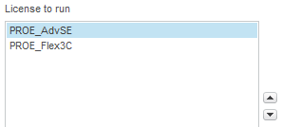
Reserving Licenses
Why change the order of licenses to run?
Large group of users
Continually changing
Notes:
Earlier I said that I like to change the order of how the licenses are read.

Slide 64
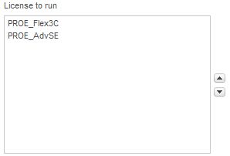
Reserving Licenses
Why change the order of licenses to run?
Large group of users
Continually changing
Smaller group of users
Mostly static
I reserve for this group
Let anyone use
PROE_AdvSE
Notes:
The Flex3C’s are for our heavy users, the AdvSE is for our occasional users.
I know who the heavy users are, and they don’t change much.
I’m always getting request for Creo from casual users, I don’t want to have to edit the options file every time someone new comes along.
When a casual users starts Creo, all the Flex3C licenses are reserved, so it rolls over to an AdvSE licenses.

Slide 65


How Licensing Works
Creo waits
3 minutes then
checks for a menu pick
Notes:
Before we can talk about how many licenses you should buy from PTC, we need to understand how licensing works under the hood.
Here is how the software makes sure you have a valid license.
After a 3 minute interval Creo waits for the user to make a menu pick.

Slide 66
How Licensing Works
When the user finally does something, it then checks if a licenses is available
Creo waits
3 minutes then
checks for a menu pick
Notes:
As soon as the user does something, the client machine then asks the server if the license is still available

Slide 67
How Licensing Works
When the user finally does something, it then checks if a licenses is available
Creo waits
3 minutes then
checks for a menu pick
The license is validated & the 3 minute timer is reset
Notes:
If the license is available the Key is issued again. And Creo waits for another 3 minutes before checking again.
Notice it’s not checking for the license every 3 minutes, it’s checking when the user makes a menu selection 3+ minutes after the last key was issued.

Slide 68

How Licensing Works
When the user finally does something, it then checks if a licenses is available
Creo waits
3 minutes then
checks for a menu pick
If license is not validated, a warning pops up
Notes:
If no licenses are available a warning pops up and your going to get an phone call from an angry user.
The software gives you 1 minute to validate, before popping up the warning

Slide 69

How Licensing Works
This is the timeout
If the user is gone, or does nothing, the license will be reclaimed
Notes:
There is another timer running. This one is on the server. It’s called the timeout
When Creo has been idle for more than the timeout setting, that is, when the user hasn’t made a menu selection for that time period, then the license is released back to the pool of available licenses.

Slide 70
How Licensing Works
When the user finally does something, Creo checks for a licenses
Notes:
When the user comes back and starts picking menus, then the client asks the server if a license is available.

Slide 71
How Licensing Works
A window pops up letting the user know the license was regained
Notes:
If a license is available Creo pops up a window and let you know you regained a license.

Slide 72
How Licensing Works
A window pops up letting the user know the license was regained
Turn this off
suppress_license_loss_dialog YES
Notes:
Honestly, the user doesn’t care. So turn off the warning.
You can turn it off with this config option:
Besides in the distant past, that popup caused problems in ProE.

Slide 73
How Licensing Works
Default timeout is
2 hours!
Notes:
If you have not explicitly set it, the timeout value is 2 hours. The license would have to sit idle for two hours before it gets released.
With a two hour timeout, almost no licenses will ever get released.

Slide 74
How People Work - Really
Three general categories
Working hard on Creo most of the day
Notes:
So let’s look at how people really work.
Sometimes you will be banging on the software for most of the day with hardly any break.

Slide 75
How People Work - Really
Three general categories
Working hard on Creo most of the day
Meetings or product research, big breaks in usage
Notes:
Other times you have meetings, or you’re doing research on the internet or in catalogs.
During the day you may have several large breaks in your usage.

Slide 76
How People Work - Really
Three general categories
Working hard on Creo most of the day
Meetings or product research, big breaks in usage
Writing a document, in Creo very little
Notes:
Other times you may be writing a document, you need a screen shot, so you open up Creo, get the image you want and then go back to work on your document.
You may only use Creo 2 or 3 times all day. Even then, for just a few minutes each time.
I think categories #2 & #3 are more typical than #1.
The exception would be dedicated drafting users. They would fall into category #1 most of the time.

Slide 77
How People Work - Really
Three general categories
Working hard on Creo most of the day
Meetings or product research, big breaks in usage
Writing a document, in Creo very little
Floating Licenses are so you can take advantage of this varied usage
Notes:
The whole point of floating licenses is so you can take advantage of this type of variable usage.
If you’re not taking advantage of it, then you’re wasting a lot of money paying for idle licenses.
The more licenses you have the more important this is.

Slide 78
How People Work - Really
Three general categories
Working hard on Creo most of the day
Meetings or product research, big breaks in usage
Writing a document, in Creo very little
Floating Licenses are so you can take advantage of this varied usage
2 hour timeout means almost no licenses would be released
Notes:
The minimum timeout is 20 minutes.
Consider that the user who goes to a meeting for 30 minutes, that license is going to get released. You might think, “big deal, it’s only going to be free for 10 minutes, what’s the point”. I’ll bet dollars to donuts that that user is gone from his desk for more than 30 minutes. It’s likely closer to 45 minutes, now were talking 25 minutes a license is freed up.
Also the meeting room is scheduled the next hour for another design meeting, and some other engineer attends that one. Now his license is going to timeout.
In the mean time you have someone writing a safety note, they pop up Creo and make a screenshot to include in their document. They used the license for 5 minutes, now it’s just sitting idle.
Honestly, it doesn’t take a lot of users to make this kind of savings add up.

Slide 79
How People Work - Really
Three general categories
Working hard on Creo most of the day
Meetings or product research, big breaks in usage
Writing a document, in Creo very little
Floating Licenses are so you can take advantage of this varied usage
2 hour timeout means almost no licenses would be released
Minimum timeout is 20 minutes
TIMEOUTALL 1200
Notes:
Modify your ptc.opt file to set the timeout to 20 minutes.
The value is in seconds. 1200 seconds is the minimum allowed value. (20 minutes)
The default is 7200 seconds (2 hours)

Slide 80
Complete ptc.opt example file
REPORTLOG +"C:\Program Files\PTC\FLEXnet Admin License Server\logs\ptcreport.log"
TIMEOUTALL 1200
GROUP flintstone fred wilma pebbles dino
RESERVE 4 PROE_Flex3c:VERSION=33.0 GROUP flintstone
GROUP rubble barney betty bammbamm
RESERVE 3 PROE_Flex3c:VERSION=33.0 GROUP rubble
Notes:
The complete ptc.opt file should now look something like this.
All the blue text is stuff we added or modified.

Slide 81
How Many Licenses?
You have to track licenses to know
Notes:
This now brings us to the question how many licenses do you really need.
Before you start tracking usage, let me emphasize that you need to set the timeout to 20 minutes, or your numbers will be wildly inflated.
There are applications out there that will track your usage and give you pretty graphs and such.
But all you really need to know for your purchase decision are the maximum concurrent users.

Slide 82
How Many Licenses?
You have to track licenses to know
ptcstatus command reports the current usage
Use information from it to build data files at 15 minute intervals
Notes:
We can get this number with a script that calls the ptcstatus command. I have mine set to run every 15 minutes.

Slide 83
How Many Licenses?
You have to track licenses to know
ptcstatus command reports the current usage
Use information from it to build data files at 15 minute intervals
Need Perl for this script:
Suggest “Active Perl” http://www.activestate.com/activeperl
Notes:
I’ll apologize at the outset, I tried to do this with just windows commands, but I’m evidently not smart enough.
This script requires that you have PERL installed on your computer. We use Active Perl.
It’s simple to install.
You have to reboot before using it.

Slide 84
How Many Licenses?
You have to track licenses to know
ptcstatus command reports the current usage
Use information from it to build data files at 15 minute intervals
Need Perl for this script:
Suggest “Active Perl” http://www.activestate.com/activeperl
Track_licenses.bat:
set PATH=%PATH%;"C:\ptc\Creo 2.0\Parametric\bin\;"C:\Perl64\bin\perl.exe"
ptcstatus.bat /nopause | perl -ne "print $1, \"\t\", scalar(localtime(time)), \"\t\", $2, \"\n\" if $_ =~ /\s+(PROE_Flex3C)\s+(\d+)\s+\d+/ ">>c:\PTC\tracking\data-FLEX3C.txt
ptcstatus.bat /nopause | perl -ne "print $1, \"\t\", scalar(localtime(time)), \"\t\", $2, \"\n\" if $_ =~ /\s+(PROE_AdvSE)\s+(\d+)\s+\d+/ ">>c:\PTC\tracking\PROE_AdvSE.txt
ptcstatus.bat /nopause | perl -ne "print $1, \"\t\", scalar(localtime(time)), \"\t\", $2, \"\n\" if $_ =~ /\s+(Mathcad)\s+(\d+)\s+\d+/ ">>c:\PTC\tracking\data-Mathcad.txt
Notes:
This is the script. I won’t go over it in great detail. But I want to point out a couple things.
I’m going to use scheduled task to run this batch file.
That task is going to run as a different user, so it’s not going to recognize PERL as a program.
That’s why the paths to Perl and the Parametric/bin folder are added in line one.

Slide 85
How Many Licenses?
You have to track licenses to know
ptcstatus command reports the current usage
Use information from it to build data files at 15 minute intervals
Need Perl for this script:
Suggest “Active Perl” http://www.activestate.com/activeperl
Track_licenses.bat:
set PATH=%PATH%;"C:\ptc\Creo 2.0\Parametric\bin\;"C:\Perl64\bin\perl.exe"
ptcstatus.bat /nopause | perl -ne "print $1, \"\t\", scalar(localtime(time)), \"\t\", $2, \"\n\" if $_ =~ /\s+(PROE_Flex3C)\s+(\d+)\s+\d+/ ">>c:\PTC\tracking\data-FLEX3C.txt
ptcstatus.bat /nopause | perl -ne "print $1, \"\t\", scalar(localtime(time)), \"\t\", $2, \"\n\" if $_ =~ /\s+(PROE_AdvSE)\s+(\d+)\s+\d+/ ">>c:\PTC\tracking\PROE_AdvSE.txt
ptcstatus.bat /nopause | perl -ne "print $1, \"\t\", scalar(localtime(time)), \"\t\", $2, \"\n\" if $_ =~ /\s+(Mathcad)\s+(\d+)\s+\d+/ ">>c:\PTC\tracking\data-Mathcad.txt
Notes:
Also notice I have separate data files for each item I’m tracking.

Slide 86
How Many Licenses?
ptcstatus.bat /nopause | perl -ne "print $1, \"\t\", scalar(localtime(time)), \"\t\", $2, \"\n\" if $_ =~ /\s+(PROE_Flex3C)\s+(\d+)\s+\d+/ ">>c:\PTC\tracking\data-FLEX3C.txt
Notes:
Here’s one line that gathers a data point for a specific license feature.

Slide 87
How Many Licenses?
ptcstatus.bat /nopause | perl -ne "print $1, \"\t\", scalar(localtime(time)), \"\t\", $2, \"\n\" if $_ =~ /\s+(PROE_Flex3C)\s+(\d+)\s+\d+/ ">>c:\PTC\tracking\data-FLEX3C.txt
Look for this:
(PROE_Flex3C)
Notes:
This orange section tells perl what to look for in the output of ptcstatus.

Slide 88
How Many Licenses?
ptcstatus.bat /nopause | perl -ne "print $1, \"\t\", scalar(localtime(time)), \"\t\", $2, \"\n\" if $_ =~ /\s+(PROE_Flex3C)\s+(\d+)\s+\d+/ ">>c:\PTC\tracking\data-FLEX3C.txt
Look for this:
(PROE_Flex3C)
Append the data to this file:
">>c:\PTC\tracking\data-FLEX3C.txt
Notes:
This red section defines what data file to append to.

Slide 89
How Many Licenses?
ptcstatus.bat /nopause | perl -ne "print $1, \"\t\", scalar(localtime(time)), \"\t\", $2, \"\n\" if $_ =~ /\s+(PROE_Flex3C)\s+(\d+)\s+\d+/ ">>c:\PTC\tracking\data-FLEX3C.txt
Look for this:
(PROE_Flex3C)
Append the data to this file:
">>c:\PTC\tracking\data-FLEX3C.txt
The output line is tab delimited.
PROE_Flex3C Fri May 9 11:46:51 2014 11
Notes:
When you run this script it will output a single tab delimited line into a data file.

Slide 90
How Many Licenses?
ptcstatus.bat /nopause | perl -ne "print $1, \"\t\", scalar(localtime(time)), \"\t\", $2, \"\n\" if $_ =~ /\s+(PROE_Flex3C)\s+(\d+)\s+\d+/ ">>c:\PTC\tracking\data-FLEX3C.txt
Look for this:
(PROE_Flex3C)
Append the data to this file:
">>c:\PTC\tracking\data-FLEX3C.txt
The output line is tab delimited.
PROE_Flex3C Fri May 9 11:46:51 2014 11
Create a scheduled task to output data periodically
schtasks /create /sc minute /mo 15 /ru "System" /tn "Track PTC Licenses" /tr C:\PTC\Track_licenses.bat
Notes:
In order to track your licenses over time, you need to set up a scheduled task that will run this command periodically.

Slide 91
How Many Licenses?
Create a scheduled task to output data periodically
schtasks /create /sc minute /mo 15 /ru "System" /tn "Track PTC Licenses" /tr C:\PTC\Track_licenses.bat
Notes:
Let’s look at the schtasks command in detail.

Slide 92
How Many Licenses?
Create a scheduled task to output data periodically
schtasks /create /sc minute /mo 15 /ru "System" /tn "Track PTC Licenses" /tr C:\PTC\Track_licenses.bat
run the script every 15 minutes:
/sc minute /mo 15
Notes:
The orange section of the line is telling it to run the script every 15 minutes:

Slide 93
How Many Licenses?
Create a scheduled task to output data periodically
schtasks /create /sc minute /mo 15 /ru "System" /tn "Track PTC Licenses" /tr C:\PTC\Track_licenses.bat
run the script every 15 minutes:
/sc minute /mo 15
Name of the scheduled task:
/tn "Track PTC Licenses"
Notes:
The red section is the name of the task it will create:

Slide 94
How Many Licenses?
Create a scheduled task to output data periodically
schtasks /create /sc minute /mo 15 /ru "System" /tn "Track PTC Licenses" /tr C:\PTC\Track_licenses.bat
run the script every 15 minutes:
/sc minute /mo 15
Name of the scheduled task:
/tn "Track PTC Licenses"
Command to run: (my bat file)
/tr C:\PTC\Track_licenses.bat
Notes:
The green section tells it what command to run: (my bat file)

Slide 95
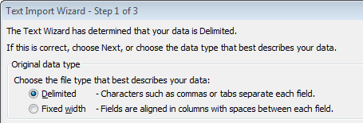
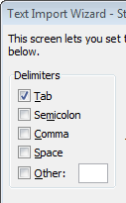
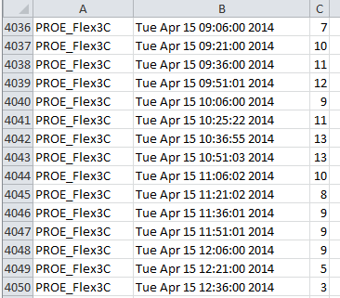
How Many Licenses?
Create a scheduled task to output data periodically
schtasks /create /sc minute /mo 15 /ru "System" /tn "Track PTC Licenses" /tr C:\PTC\Track_licenses.bat
run the script every 15 minutes:
/sc minute /mo 15
Name of the scheduled task:
/tn "Track PTC Licenses"
Command to run: (my bat file)
/tr C:\PTC\Track_licenses.bat
Import data file into Excell as tab delimited
Notes:
Now after some time collecting data you can read the data file into excel as a tab delimited file.
You’ll get the feature name, date-time, and number of license, in separate columns.

Slide 96
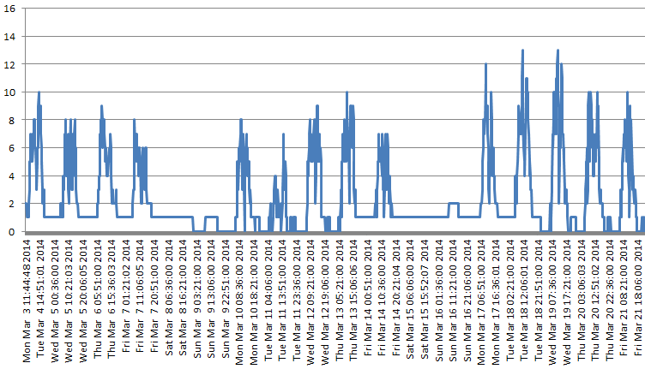
How Many Licenses?
Create a scheduled task to output data periodically
schtasks /create /sc minute /mo 15 /ru "System" /tn "Track PTC Licenses" /tr C:\PTC\Track_licenses.bat
run the script every 15 minutes:
/sc minute /mo 15
Name of the scheduled task:
/tn "Track PTC Licenses"
Command to run: (my bat file)
/tr C:\PTC\Track_licenses.bat
Import data file into Excell as tab delimited
Notes:
If you want, you can use columns B & C to make a pretty graph for your boss.
They always like that sort of thing.
Or, just sort on the third column to find the maximum usage number.

Slide 97
This script will not…
Will not track usage of groups or divisions
Flexera has software for that – may be worth the money
Or use “CADminTools license tracker”
See Edwin’s talk later this morning
Notes:
What this script is not going to do for you is track how much time specific people are using the software.
So it’ won’t help you figure out how much to charge different groups for their useage.
There is software from Flexera that will track all types of events and usage, but it’s not free.
If you have lots of users, it may be worth buying.
There’s another talk later this morning that may also help you with that task.
That complete my first topic, now let’s talk about the flexnet sofware that ships with Creo.

Slide 98
lmadmin – new licensing software
Former ProE sites may still be running lmgrd
Notes:
If you were already using ProE, it’s highly likely you didn’t install the license server that comes with Creo.
The old license will continue to work just like it always has.

Slide 99
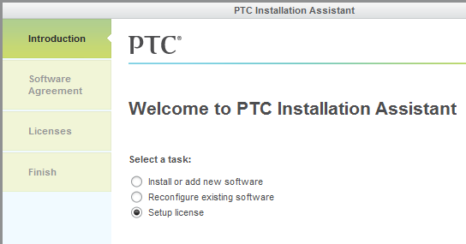
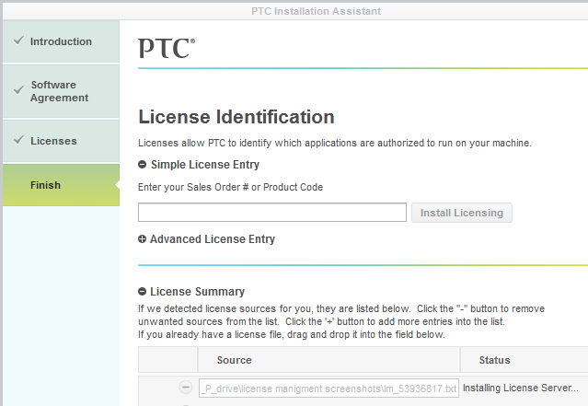
lmadmin – new licensing software
Former ProE sites may still be running lmgrd
lmadmin comes with Creo
How to install??? No button in user interface!
Notes:
If you did a fresh install, you will have noticed that there is no menu or pick in the UI to install the license server.
It’s so non-obvious I had to call PTC to find out how.
That seems like bad UI design to me. But then I’m a luddite.

Slide 100
lmadmin – new licensing software
Former ProE sites may still be running lmgrd
lmadmin comes with Creo
How to install??? No button in user interface!
Drag & drop license file here
Notes:
What you do is drag and drop the license file you received from PTC into the licensing field.

Slide 101
lmadmin – new licensing software
Former ProE sites may still be running lmgrd
lmadmin comes with Creo
How to install??? No button in user interface!
Drag & drop license file here
Install starts automatically
Notes:
At that point flexnet will automatically start installing.
You don’t have any control over where it gets installed.

Slide 102
lmadmin – new licensing software
Former ProE sites may still be running lmgrd
lmadmin comes with Creo
How to install??? No button in user interface!
Default install location
C:\Program Files\PTC\FLEXnet Admin License Server
Drag & drop license file here
Install starts automatically
Notes:
The default location is here:

Slide 103
lmadmin – new licensing software
Former ProE sites may still be running lmgrd
lmadmin comes with Creo
How to install??? No button in user interface!
Default install location
C:\Program Files\PTC\FLEXnet Admin License Server
Differences
lmadmin bin lmgrd bin
========== ========
i486_nt_ptc_setvars.exe
lmtools.bat
lmutil.bat
ptcshutdown.bat
ptcflush.bat ptcflush.bat
ptchostid.bat ptchostid.bat
reconfigure.exe ptcsetup.bat
ptcadminstartservice.bat ptcstartserver.bat
ptcstatus.bat ptcstatus.bat
uninstall.exe
Drag & drop license file here
Install starts automatically
Notes:
You will notice some differences in the bin folder.
Familiar commands like ptcshutdown are missing.

Slide 104
lmadmin – new licensing software
lmtools is still in the installation
C:\Program Files\PTC\FLEXnet Admin License Server\i486_nt\obj
Notes:
Now lmtools is still here, but it’s in a different directory.
However you don’t really need it.

Slide 105
lmadmin – new licensing software
lmtools is still in the installation
C:\Program Files\PTC\FLEXnet Admin License Server\i486_nt\obj
lmadmin has a web interface
Notes:
Lmadmin has a web base interface.

Slide 106

lmadmin – new licensing software
lmtools is still in the installation
C:\Program Files\PTC\FLEXnet Admin License Server\i486_nt\obj
lmadmin has a web interface
Win7 Start Menu
Notes:
You can access it on the server from the Windows Start Menu, under All Programs, as shown here.

Slide 107
lmadmin – new licensing software
lmtools is still in the installation
C:\Program Files\PTC\FLEXnet Admin License Server\i486_nt\obj
lmadmin has a web interface
http://stonequary:8080
Win7 Start Menu
License server name
Notes:
Or from any machine you can go to this web address:
In this example “stonequary” is the name of the server.

Slide 108
lmadmin – new licensing software
lmtools is still in the installation
C:\Program Files\PTC\FLEXnet Admin License Server\i486_nt\obj
lmadmin has a web interface
http://stonequary:8080
Advantages of lmadmin
  Reread license from web interface
Win7 Start Menu
License server name
Notes:
There are some advantages of the new software.
You can reread the license from the web interface.

Slide 109
lmadmin – new licensing software
lmtools is still in the installation
C:\Program Files\PTC\FLEXnet Admin License Server\i486_nt\obj
lmadmin has a web interface
http://stonequary:8080
Advantages of lmadmin
  Reread license from web interface
  Ptcflush restricted by default to license admins
Win7 Start Menu
License server name
Notes:
Ptcflush is now restricted by default to license admins.

Slide 110
lmadmin – new licensing software
lmtools is still in the installation
C:\Program Files\PTC\FLEXnet Admin License Server\i486_nt\obj
lmadmin has a web interface
http://stonequary:8080
Advantages of lmadmin
  Reread license from web interface
  Ptcflush restricted by default to license admins
  Early return of borrowed licenses
Win7 Start Menu
License server name
Notes:
You can return borrowed licenses early

Slide 111
lmadmin – new licensing software
lmtools is still in the installation
C:\Program Files\PTC\FLEXnet Admin License Server\i486_nt\obj
lmadmin has a web interface
http://stonequary:8080
Advantages of lmadmin
  Reread license from web interface
  Ptcflush restricted by default to license admins
  Early return of borrowed licenses
  Email alerts can be set up
Win7 Start Menu
License server name
Notes:
You can set up email alerts.

Slide 112
lmadmin – new licensing software
Differences in lmadmin
  Ptcflush, (lmremove) requires admin access
  Remote shut down is disabled by default
Service default settings are here:
C:\Program Files\PTC\FLEXnet Admin License Server\conf\server.xml
startup options:
-adminOnly <yes|no>
A value of 'yes' restricts usage of lmutils such as lmdown, lmreread,
lmswitch, lmswitchr, lmremove and lmnewlog to license administrator who
is by default root. If there is a UNIX group called lmadmin, then use
is restricted to only members of that group. If root is not a member of
this group, then root does not have permission to use any of the above
utilities. On Windows no user can use the above command-line utilities.
The Default value is 'yes'.
-allowLicenseReclaim <yes|no>
Controls whether or not one can reclaim licenses that are currently
checked out. This setting is recorded in the configuration file
and will apply to all subsequent executions until changed.
Default value is 'no'.
-allowStopServer <yes|no>
Controls whether or not one can stop the license server from a local
client (lmadmin or the web UI). This setting is recorded in the licens
server configuration file and will apply to all subsequent executions
until changed. Setting this value to 'no' will also force the option
-allowRemoteStopServer to 'no'. The default value is 'yes'.
-allowRemoteStopServer <yes|no>
Controls whether or not one can stop the license server from a remote
client (lmadmin or the web UI). This setting is recorded in the licens
server configuration file and will apply to all subsequent executions
until changed. The default value is 'no'
Waiting on PTC for recommend process
To modify these settings.
Notes:
The major differences are:
it takes an admin to flush licenses
You can’t remotely shutdown the server.
These and other things can be changed with startup options.
I’m still waiting on PTC for the recommended method of changing them.

Slide 113
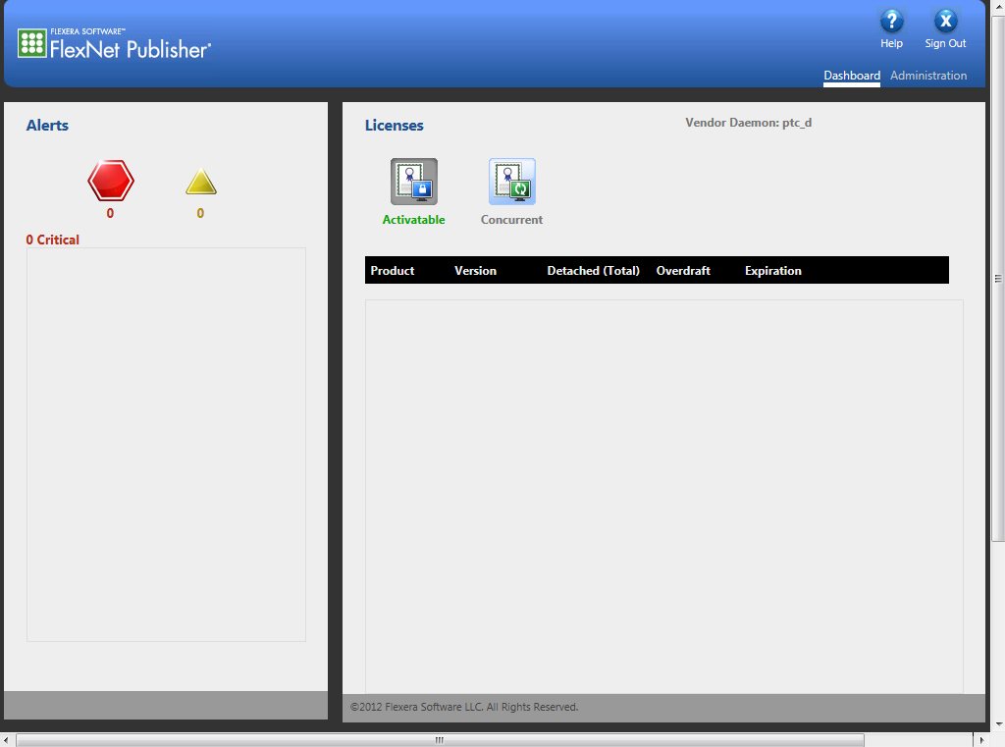
lmadmin – new licensing software
Web User Interface
Creo Licenses shown here
Alerts
Notes:
This is what the web UI looks like when you open it.

Slide 114
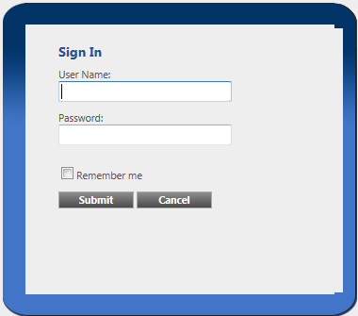
lmadmin – new licensing software
Web User Interface
Creo Licenses shown here
Admin Login
Alerts
Default =
admin
admin
Must change
after login
Notes:
To modify the setup you need to pick on the Administration link and log in.
The default log in is admin, admin,
but you will have to change the password as soon as you log in.

Slide 115
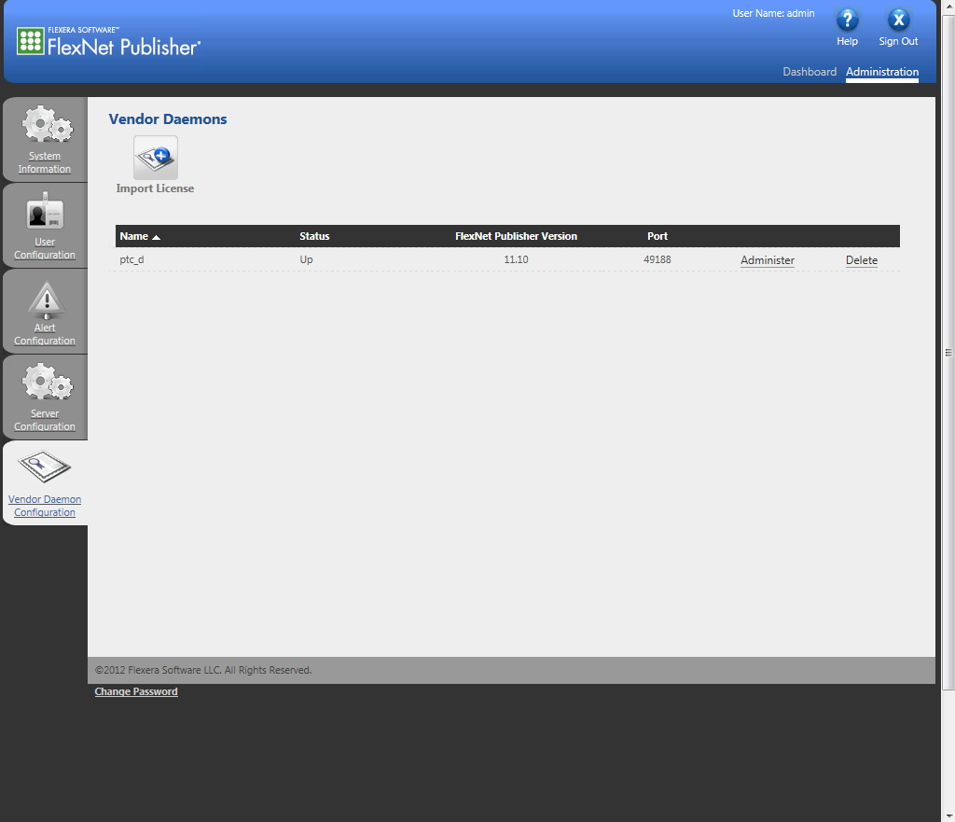
lmadmin – new licensing software
Update license file
This tab
Notes:
If you want to load in a new license file you pick the Vendor Daemon Configuration tab on the left

Slide 116
lmadmin – new licensing software
Update license file
Read new license file
This tab
Notes:
and Import License at the top.

Slide 117
lmadmin – new licensing software
Update license file
Read new license file
This tab
See details
Notes:
Picking on Administer link lets you do other tasks.

Slide 118
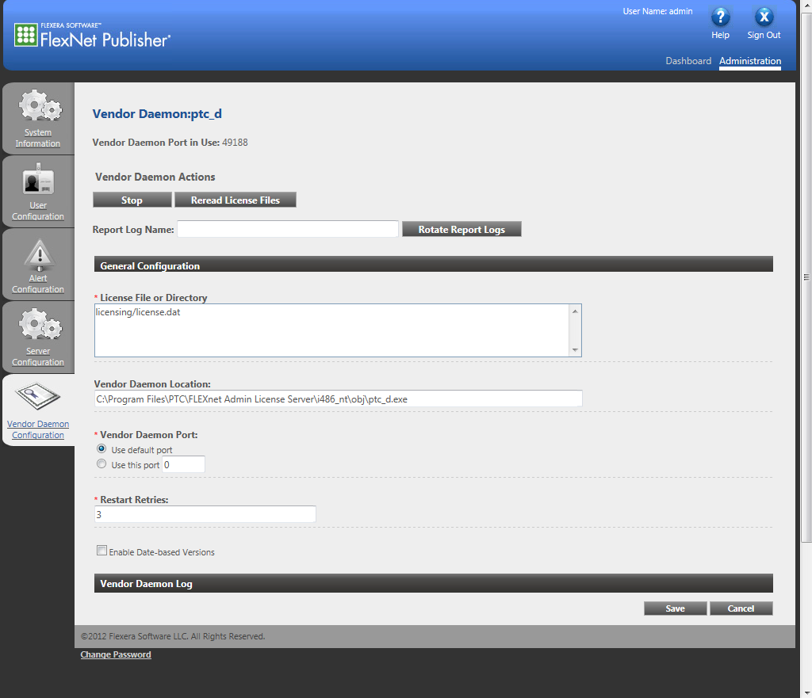
lmadmin – new licensing software
Reread License – update ptc.opt
Stop the license
This tab
Notes:
You can stop the server, or you can re-read the license, which is how you would get modifications to the ptc.opt file into the system.

Slide 119
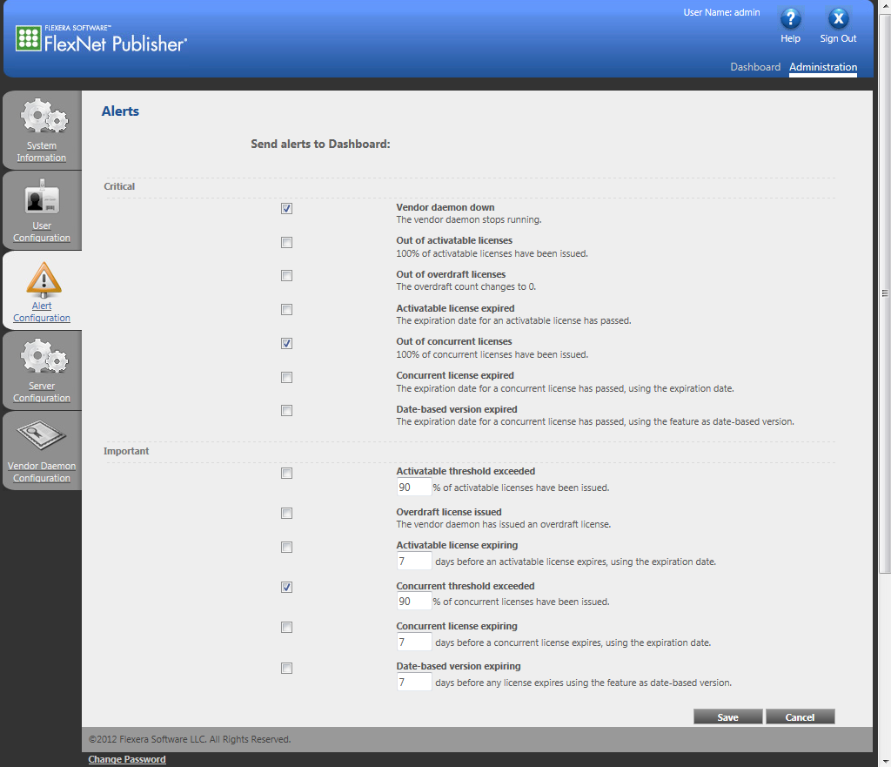
lmadmin – new licensing software
Alert Condition Setup
I only want these alerts
Vendor deamon down
Out of concurrent licenses
Concurrent threshold exceeded
This tab
Notes:
The alert Configuration tab allows you to select what Alerts you want to be notified of.
I decided I only need to know:
if it can’t serve licenses
If I’m out of licenses,
And if my license usage hits a threshold limit.

Slide 120
lmadmin – new licensing software
Send alerts via email
C:\Program Files\PTC\FLEXnet Admin License Server\examples\alerter.
Modify the last line in runalerter.bat
From : java -classpath lib\alerter.jar alerter.Alerter %CMD_LINE_ARGS%
To : java -classpath "lib\alerter.jar;lib\*" alerter.Alerter %CMD_LINE_ARGS%
On the license server, open a command shell with “Run as Administrator”.
CD to the folder where the alerter is: C:\Program Files\PTC\FLEXnet Admin License Server\examples\alerter
Command syntax is:
runalerter.bat -port "8080" -user "<username>" -password "*****" -smtpServer "<SMTP servername>" -smtpUser "<username>" -smtpPassword "*********" -toAddress "<email address>" -fromAddress "<email address>” -interval "60"
where:
-user = the license server admin name. If you haven’t changed it it’s admin
-password = the license server admin password. You are forced to change this when you first log in as admin in the web interface.
-smtpServer = the name of your mail server
-smtpUser = your username on the mail server
-smtpPassword = your password on the mail server
-toAddress = The email address you want the alert sent to. Your address typically. If you have major domo, this can be a group
-fromAddress = Your email address
-interval = number of seconds to wait after an alert happens before the email gets sent.
Important Note: You have to leave the command window up. The process will exit, if you exit the window.
Notes:
Now you can set up lmadmin to send emails to you whenever there is an alert condition.
I won’t go over this in detail. There should be a TPI coming from PTC pretty soon.
I just got this information from PTC last week.

Slide 121
?

Slide 122
My Contact Info
David Haigh
  Phone: 925-424-3931
  Fax: 925-423-7496
  Lawrence Livermore National Lab
  7000 East Ave, L-362
  Livermore, CA 94550
  Check out my previous presentations
    ProE Admin 101
    Creo Admin 101
    Creo Admin 102
    An Admins Guide to Product View Publishing

Slide 124
Appendix
Licensing Log file
In the flexnet folder, look in Licensing/ptclmgrd.log
You can see:
  When and who has licenses
  When they have been released
  When someone has been denied a license
  When a license has been flushed manually

Slide 125
Appendix
Allowable options in the ptc.opt file:
  EXCLUDE
  EXCLUDEALL
  GROUP
  HOST_GROUP
  INCLUDE
  INCLUDEALL
  MAX
  RESERVE
  TIMEOUT
  TIMEOUTALL
Some of these are high overhead for the administrator.
I only use Group, Reserve, and Timeoutall.

Slide 126
Appendix
Laptop Install
Installing on a laptop or other machine with multiple NIC cards.
There are two common problems you will run into when trying to license to a laptop.
  Windows will disable the NIC card if it’s not plugged into a network. This is called media sensing
  Since you likely have a wireless card and a hardwire NIC, there can be confusion between them.
Media Sensing
Add this registry setting:
HKEY_LOCAL_MACHINE\System\CurrentControlSet\Services\Tcpip\Parameters\
Name: DisableDHCPMediaSense
Data type: REG_DWORD (Boolean)
Value: 1

Slide 127
Appendix
Laptop Install – NIC sort order
The PTC_HOSTID must be derived from the Physical Address of a network card installed on the machine
  The network card from which the PTC_HOSTID was derived must be enabled but need not be connected to an active network
  Change the priority of desired network card
Open the Windows registry editor by running regedit from a command prompt or the Windows "Run" Menu.
Expand the following key
HKEY_LOCAL_MACHINE\SOFTWARE\Microsoft\Windows NT\CurrentVersion\NetworkCards
  This key will contain numbered folders corresponding to all of the network cards installed on the machine
  Locate the desired folder by matching the "Description" field in the Registry Editor to the "Description" line from the ipconfig /all output for the desired network card
  Rename this folder to number 1
  Close the registry editor
  Restart the machine

Slide 128
Appendix
Licensing through a firewall
Here is what you need to do.
Add the port to the deamon line in your licenses file.
SERVER __HOSTNAME__ PTC_HOSTID=<mac address> 7788
DAEMON ptc_d __PTCD_PATH__ 7788
Then open that port in your firewall

Slide 129

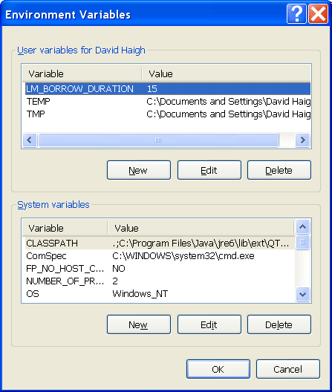
Appendix
Borrowing Licenses
You can make it easy for your users to borrow licenses by giving them a shortcut to the borrow program.
Create a shortcut of <loadpoint>\parametric\bin folder\ptcborrow.bat
I renamed it and gave it a unique icon & put it on the users desktop
PTC status shows if you have borrowed a license with an up caret.
PROE_Flex3C 3 7
^(fred@coaststarlight) PROE_Flex3C stonequarry 7788 3750
To borrow for more than 5 days
Set up a Windows Environment Variable for the borrow duration
set it at 15 days
LM_BORROW_DURATION

Slide 130
Appendix
Borrowing Simulate Licenses
In order to borrow these applications, you have to:
  Get in to simulate
  Do a solve before you exit Creo
If you just get into the application you will not be able to solve once your disconnected from the server.
Check ptcstatus to see that you have the up caret next to both of these:
MECBASICENG_License 0 33
MECBASICUI_License 0 33

