Slide 1
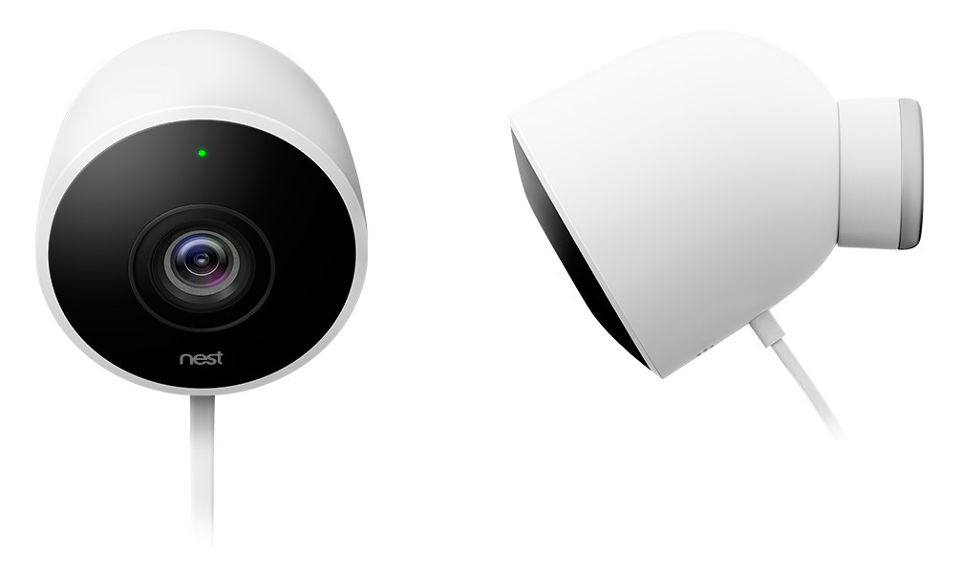
Nest Cam (Outdoor)
Smart, Connected Product
SCP Stack

Slide 2
Check the product specifications & video here
https://nest.com/camera/meet-nest-cam-outdoor/
https://www.youtube.com/watch?v=ciuIYGr5bfQ

Slide 3
SCP Stack
The product should have 5 criteria to be a Smart, Connected Product :
1 - Product Infrastructure (physical hardware, chase/casing and software/firmware) inside the product.
2- Sensors to collect the data from the product (image / position / speed ….)
3- Connectivity to the world wireless (wifi / Bluetooth) or wired or via cellular.
4- Analytics and algorithm to be applied to these data collected from the product.
5- Smart application on mobile phone to mange, monitor, and control the product.

Slide 4
Smart Apps
Analytics
Connectivity
Sensors
Product Infrastructure

Slide 5
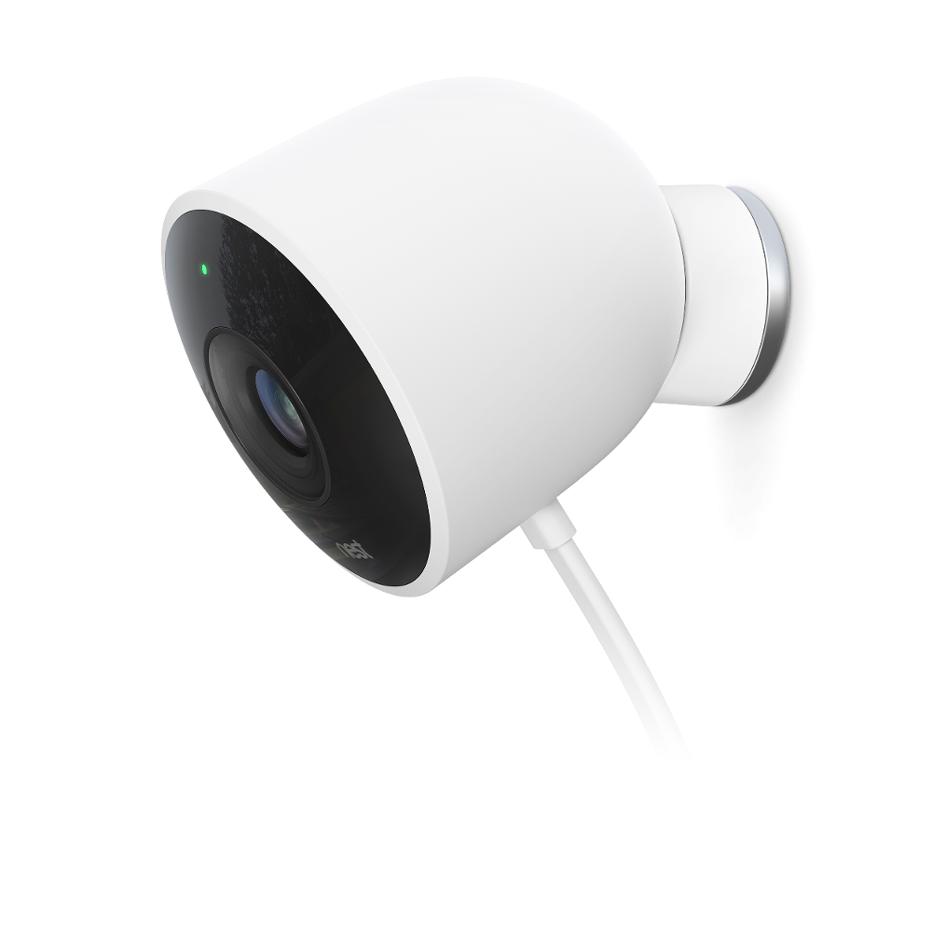
For Nest Cam (Outdoor)
The camera chase with it’s power supply and it’ll all physical components (like lens, IR, wire, stand…..)
Product Infrastructure

Slide 6
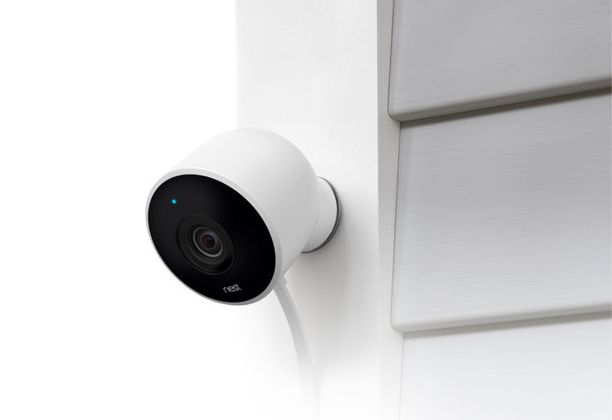
For Nest Cam (Outdoor)
Sensor here is the camera itself, which can capture image/ video and detect any body moving outside.
Sensors
Product Infrastructure

Slide 7

For Nest Cam (Outdoor)
Connection to the internet wireless.
Connectivity
Sensors
Product Infrastructure

Slide 8
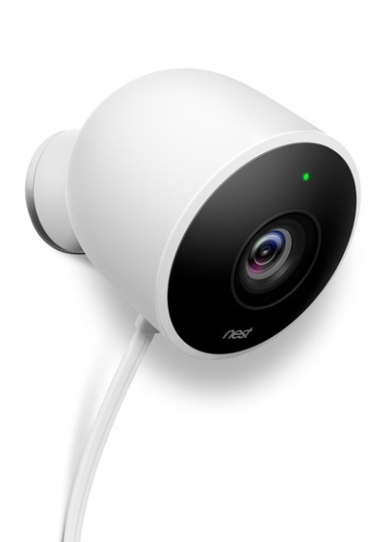
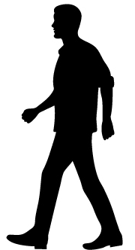
For Nest Cam (Outdoor)
Nest will detect if someone foreign moves outdoor
Analytics
Connectivity
Sensors
Product Infrastructure

Slide 9

For Nest Cam (Outdoor)
Smart Apps
You will receive notification once if someone moves, you’ll see live video on the Nest application on your mobile.
Analytics
Connectivity
Sensors
Product Infrastructure

Slide 10
Thanks

