Slide 1
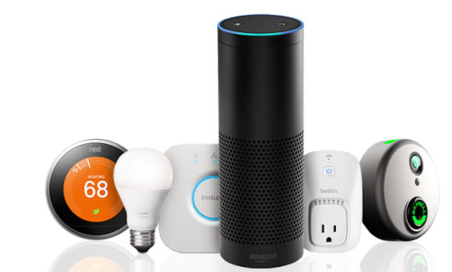
IoT Vignette: Amazon Echo
Product: Amazon Echo
  Hands-free speaker, which among many things, lets you control connected products in your home with your voice
Why It Matters
  Simplifies adoption & usage of smart connected products in home
    User only need to use their voice to control product
    Proliferation of connected products that support Alexa support out of the box
      Lights, Cameras, Security, Appliances, TVs, Speakers, Outlets, etc.
  Intelligent devices are obsoleting need for ‘Home Operating Systems’
  Echo reflected Amazon’s first attempts to expand its device portfolio beyond the Kindle e-reader
  71% of home buyers want smart home-ready houses¹
“Buyers say they’re willing to pay extra for ‘smart’ homes”, Coldwell Banker Real Estate Study, By Kenneth R. Harney, Washington Post August 24

