Slide 1
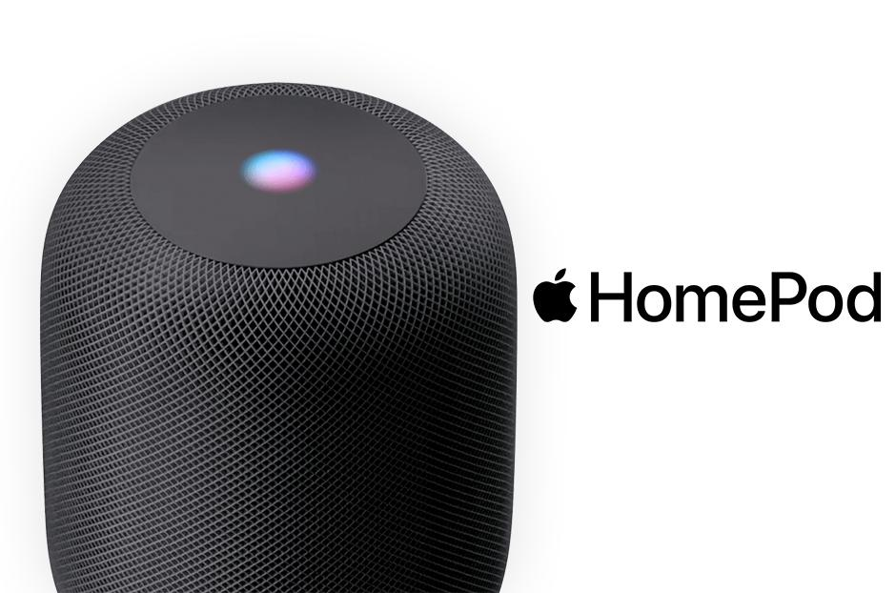

Slide 2
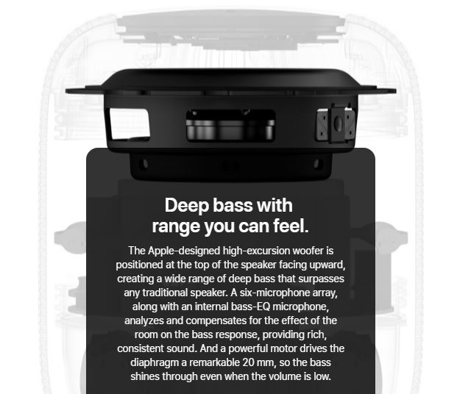
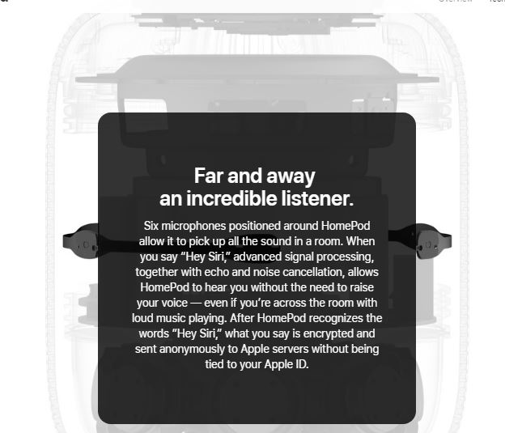

Physical
Smart
Connectivity

Slide 3
Monitor
Control & optimize
Six microphones positioned around HomePod allow it to pick up all the sound in a room. When you say “Hey Siri,” advanced signal processing, together with echo and noise cancellation, allows HomePod to hear you without the need to raise your voice — even if you’re across the room with loud music playing. After HomePod recognizes the words “Hey Siri,” what you say is encrypted and sent anonymously to Apple servers without being tied to your Apple ID.
Automate
Setting up HomePod is quick and magical. Simply plug it in and your iOS device will detect it. Equipped with spatial awareness, HomePod automatically tunes itself to give you optimal sound — wherever it’s placed. Pair it with a second HomePod to create an unmatched stereo experience. And bring multiroom audio to your whole home with AirPlay 2.
An Apple-designed A8 chip orchestrates all the remarkable audio innovations inside HomePod. Like advanced signal processing so Siri can hear you over the music. Real-time studio-level processing that maximizes the bass while minimizing distortion. Buffering that’s even faster than real time. And upmixing of both direct and ambient audio. You get amazing sound, every single time.

