Slide 1
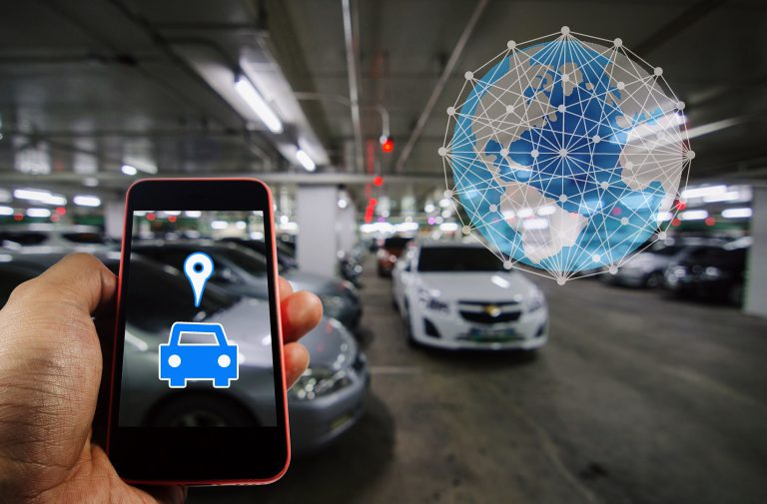
Automated Car Parking System
With cities and urban areas getting crowded by the minute, finding a parking space is nothing short of a challenge.
It is not only time-consuming but also quite frustrating. Thanks to IoT, there’s a solution for solving the parking problem crisis.
This IoT-based smart parking system is designed to avoid unnecessary travelling and harassment in the search for an appropriate parking area.

Slide 2
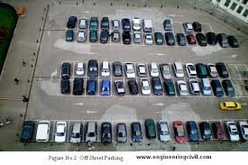
So, if you are at a parking space, this system uses an IR sensor to monitor the entire area during the run time and provide you an image for the same.
This allows you to see any free spaces in the parking lot and drive straight to it without wasting any time in looking for a parking space. Also, the system is tuned to open the car gate n only if there are empty slots available in a parking space.

Slide 3
Objectives:
In the Projects
Reduce traffic mess caused by an unplanned parking system.
Optimize available parking space.
To reduce harmful carbon emissions and save fuel.
Increase safety of vehicles and vehicle owners. 5) Time saving.
Compoanants:-
  Arduino - any board
  Infrared proximmity sensor
  (pic 2 & 3 - both are functional)
  330r resistor
  some LED’s
  Servo motor - any model or size you wish.

Slide 4
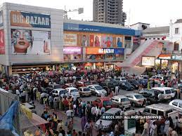
Advantages of system:-
Lesser traffic.
Lesser pollution .
Exploring Revenue.
Increased Safety .
Real-Time Data and Trend Insight.
Applications of system:
Office Buildings:
Super bazar Complex:
Railway stations and Airports:

