Slide 1
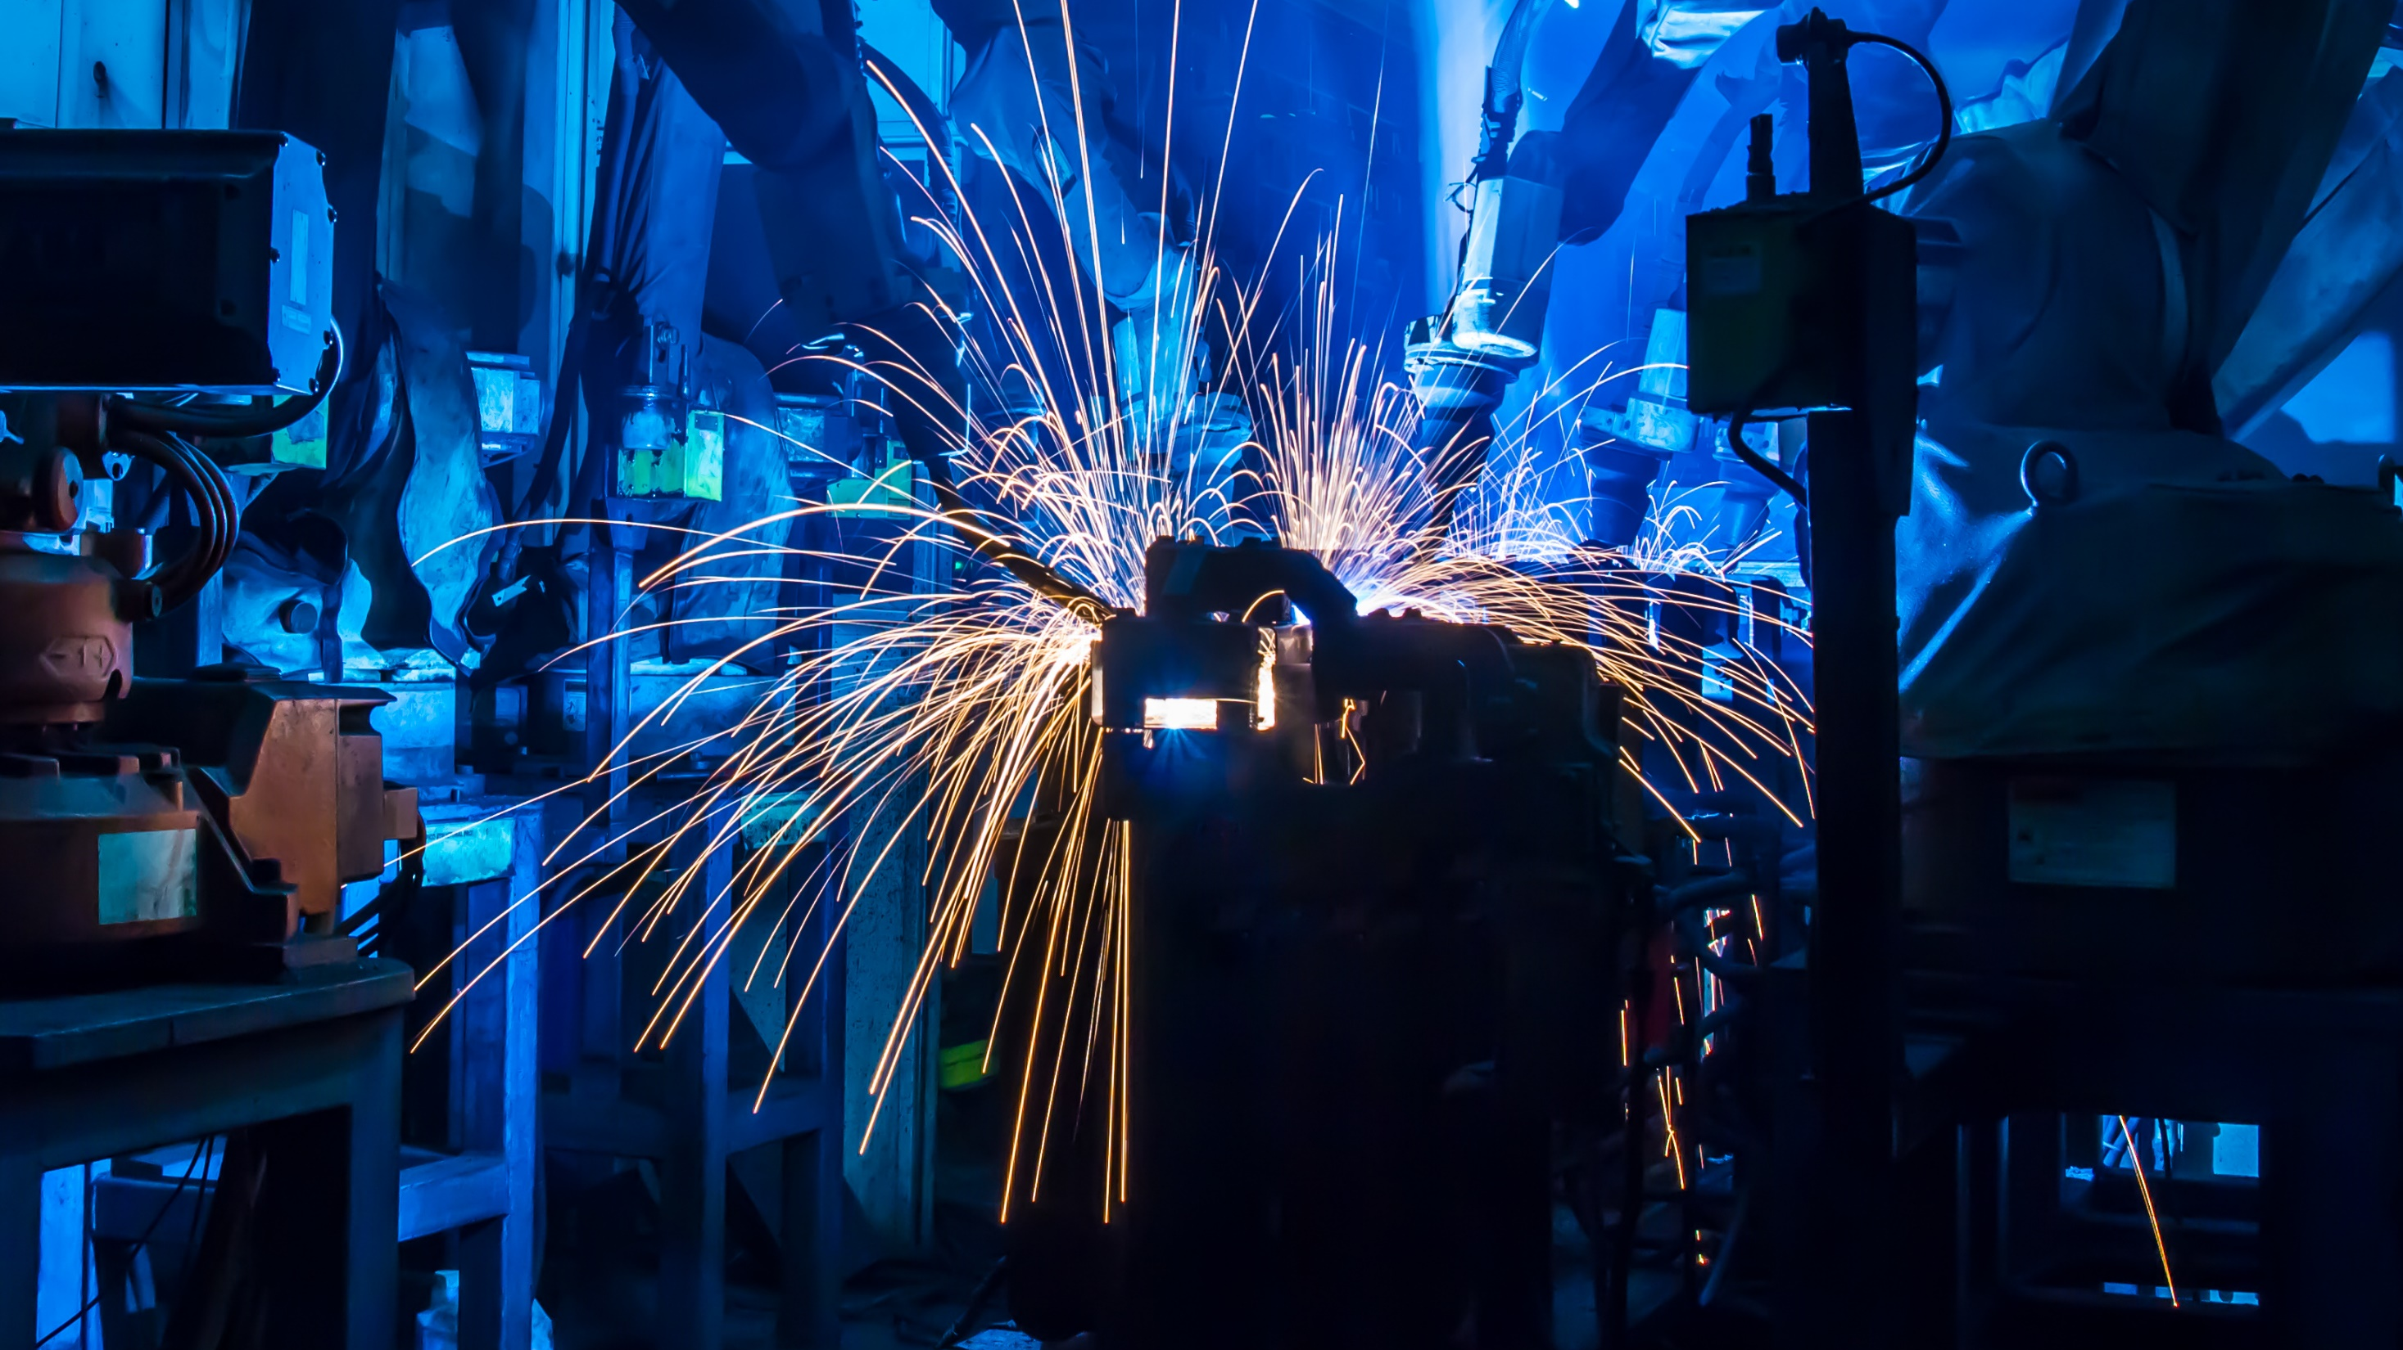

What’s new in the ThinWorx Manufacturing Apps 8.1

Slide 2

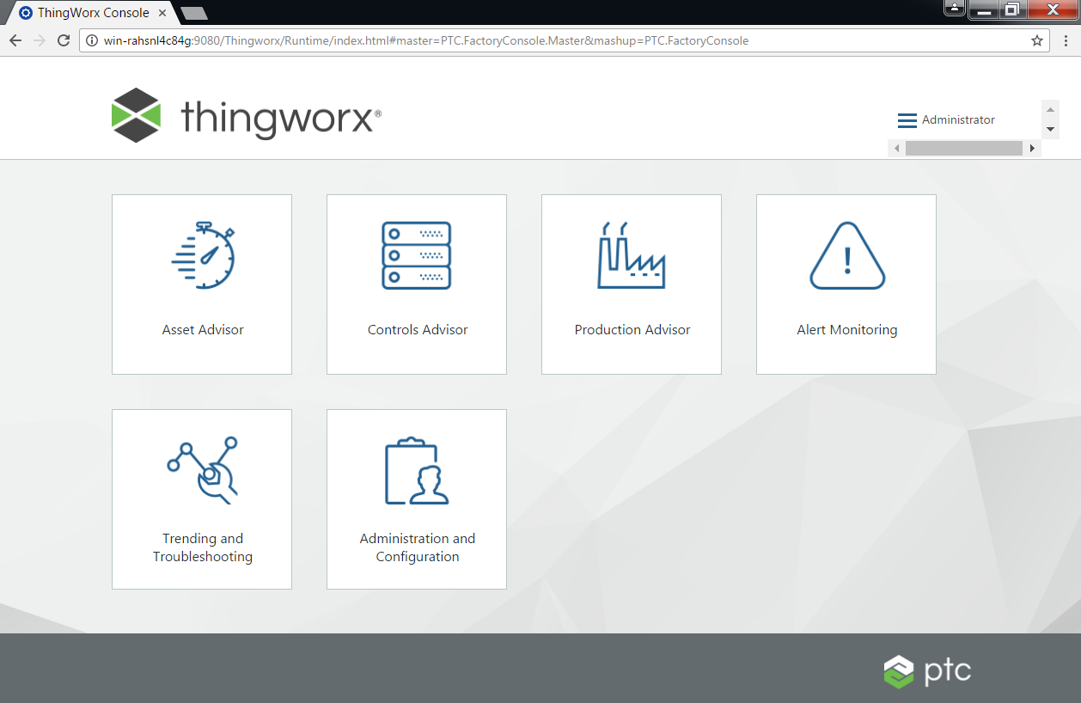
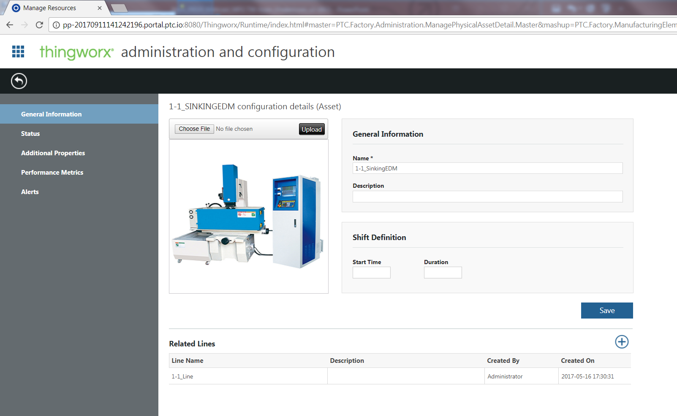

Install, connect, CONFIGURE in less than an hour
Fast to deploy
Fast to configure
Role-based insight
Flexible to evolve
Built on ThingWorx
Easy to try and buy
60
mins
Notes:
Implemented in almost 600 factories. We took top 3 use cases and created starter apps to accelerate IIoT journey
Get IIoT started in Your Factory In 60 minutes
Fast to deploy
Role-based insight – role-based apps provide real-time, actionable access to operational information for proactive and faster decision making
Flexible to evolve – code-less app extensibility for rapid continuous innovation
Built on the ThingWorx Platform – a robust, purpose-built industrial IoT platform that includes technologies & tools that enable you to rapidly develop, deploy and extend apps and augmented reality experiences
Easy to try and buy… download free starter apps and experience them live on your production data. Upgrade to unlock capabilities to maximize value and flexibility

Slide 3


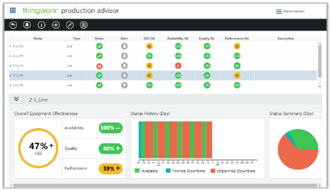
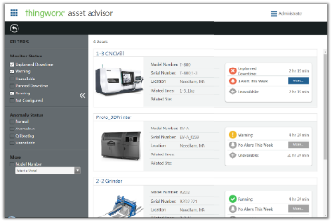
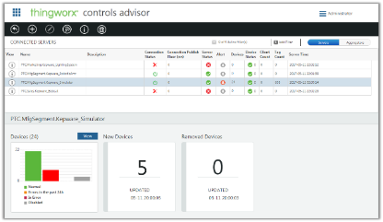
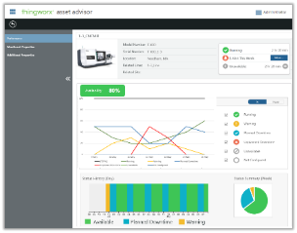
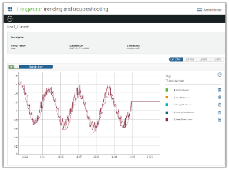
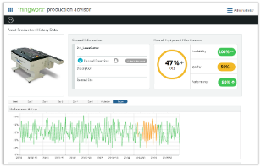
ThingWorx manufacturing apps
Transform your performance by giving your operations teams unprecedented capabilities to see, understand and act in real time. ThingWorx manufacturing apps accelerate your time-to-value and offer unmatched flexibility.
ThingWorx Production Advisor
ThingWorx Asset Advisor
ThingWorx Controls Advisor
Plant Manager
Maintenance
Controls Engineer
Notes:
Introducing ThingWorx Manufacturing Apps
Transform your results by giving your team members unprecedented capabilities to see, understand and act in real time. ThingWorx manufacturing apps accelerate your time-to-value and offer unmatched flexibility.
Built on PTC’s industry-leading IoT platform, ThingWorx, this set of role-based apps can be installed and configured in under an hour without impacting production. They are 100% web-enabled and accessible via any browser—providing you and your team members the ability to view, understand, and act on industrial data in real time
Includes:
Production Advisor
Asset Advisor
Controls Advisor

Slide 4
What's New

Slide 5


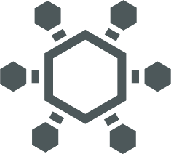


Apps Support ThingWorx 8.1
The apps now support ThingWorx 8.1
Purpose-Built for Industrial IoT
Quickly & Easily Develop, Deploy & Extend
Ultimate
Flexibility
Vibrant
Ecosystem
Notes:
Metrics reporting
Enhanced app key security
New composer and added features
Anomaly detection accuracy improvements
Load configuration projects from Kepware
Bug fixed

Slide 6

General Improvements
Patching & Upgrades
  Using the Manufacturing Apps Installer you can upgrade from 8.0.1
    *coming with the installer release in a few weeks
  Streamlined patching customers as issues are found
  New installer technology to align with ThingWorx platform
    You’ll see a merged Kepware + ThingWorx + Apps installer in the near future
App Improvements
  Fixed bugs with acknowledging alerts

Slide 7
App Improves
Controls Advisor
  You can now retrieve the KEPServerEX connection information incase the connection is lost or deleted
  Minor UI improvements
    Ex. hide/show the detail view
Asset Advisor
  Updated the UI for anomaly status to avoid confusion with machine status
  Asset Advisor for service is now a separate product
Production Advisor
  Improved the status history widget to align with Asset Advisor

Slide 8
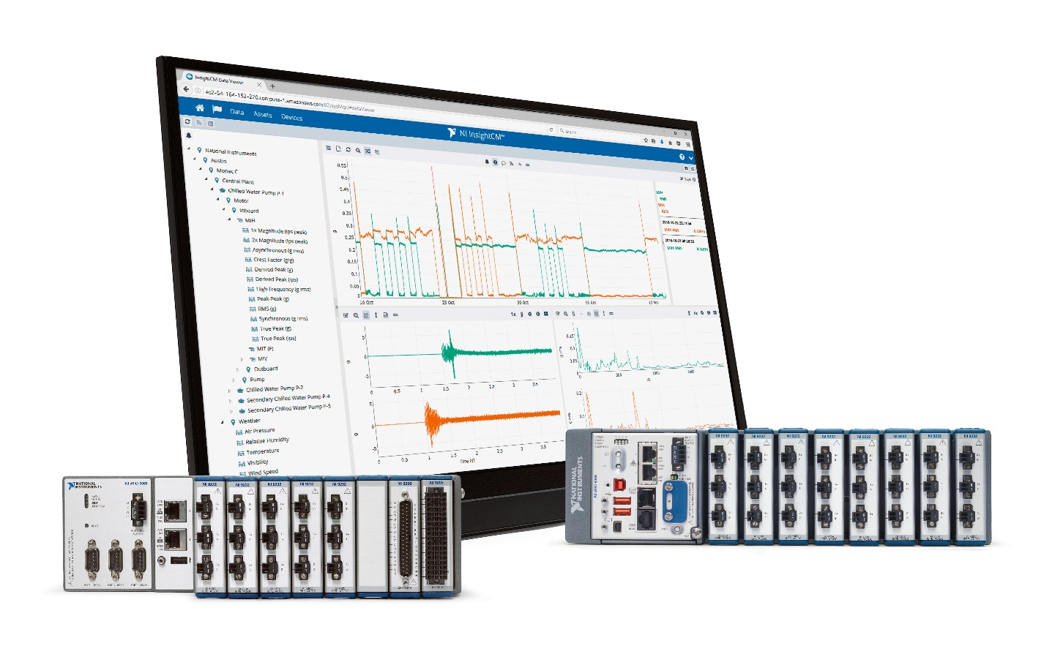
Added Support for NI InsightCM
Application software tailored for online monitoring applications
Configuration-based acquisition and data management tools
Wide range of dynamic waveform and static sensor input options
Deployment-ready hardware bundles available
Complete accessibility to data
Connectivity to third-party systems and analytics via LabVIEW
Notes:
NI has been in the monitoring space for 30 years, ever since the first release of LabVIEW. Since then, NI has been adding capabilities for monitoring specific hardware, specific software functionality to support monitoring applications, and data storage & management technologies. NI has taken these technologies and created vertical application software that is designed to support online monitoring applications. Now, you can use a customizable framework to add your own application-specific IP instead of building the entire framework from the ground up.
InsightCM offers the following benefits to companies who adopt this solution:
Wide breadth of I/O: monitor vibration, process, and electrical in the same system. Typically these are disparate systems
Flexibility to customize:
Accessibility to data: get access to your data via TDMS to share it with third-party applications to allow you to gain knowledge from your data
Absolute flexibility: the only solution on the market that you can modify: customize your I/O, develop your analytics, communicate with other services, and integrate your third-party hardware using a LabVIEW-based API with the InsightCM SDK

Slide 9
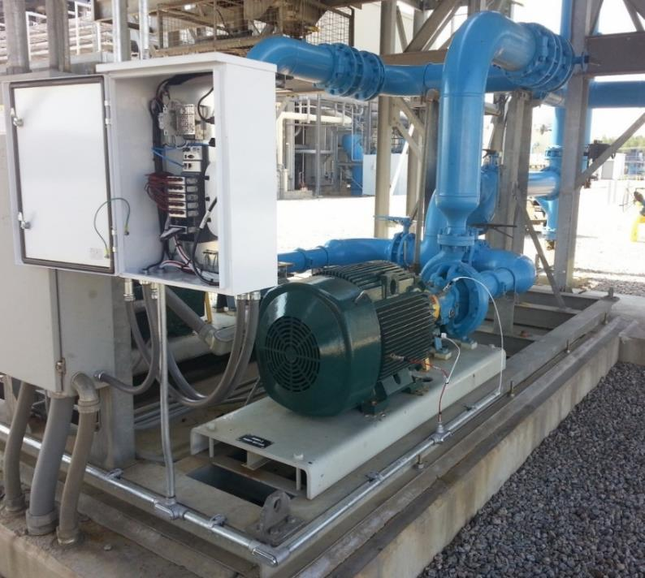
NI Monitoring Devices Installed at Edge
Panel
NI Monitoring Device
Accelerometer
Tachometer
Temperature
Oil quality
Asset (pump)
Notes:
This picture demonstrates a real-world installation of the NI Monitoring Devices; we’ll see another later when we get to the demo.
The pump is being monitored using four different types of sensors which are wired to the NI Monitoring Device in the panel. Note that even though only four sensors are being used in this picture, there are many additional inputs available, meaning a single monitoring device can be used for multiple assets. InsightCM includes the capabilities to associate specific physical channels with specific assets.

Slide 10
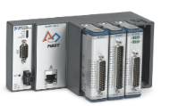
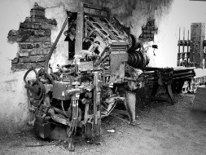
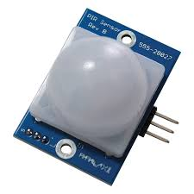
ThingWorx + InsightCM Integration
Connect to InsightCM using the Kepware OPC UA Client Driver
PTC: enhance the Client Driver as/if needed
NI: enhance the InsightCM OPC UA interface if needed
Requirements
Connect to one or more InsightCM servers
Provide access to the waveform feature data (average, max, min, FFT, etc)
Update rate for feature and status data at a maximum of 1 update/minute
Make the NI data available in the Manufacturing Apps + ThingWorx Platform and all capabilities (analytics, integration, AR, etc)
MFG Apps
ThingWorx
Kepware
OPC UA
InsightCM
cRio
Benefits
Anomaly detection to predict machine failure
Connect/sensorize any machine
Lick & Stick

Slide 11
“G” Release – end of Year
Support for ThingWorx 8.2
Design Thinking Improvements
  Speed up configuration of assets
  Centralize configuration of apps and make it more intuitive
  Improvements in workflow and user feedback
Improvements to make it easier to extend apps
National Instruments TestStand
  Connector to NI end-of-line testers
Asset Advisor
  Performance improvements when you have many assets
Production Advisor
  New widgets and layouts
  Custom KPI support

Slide 12
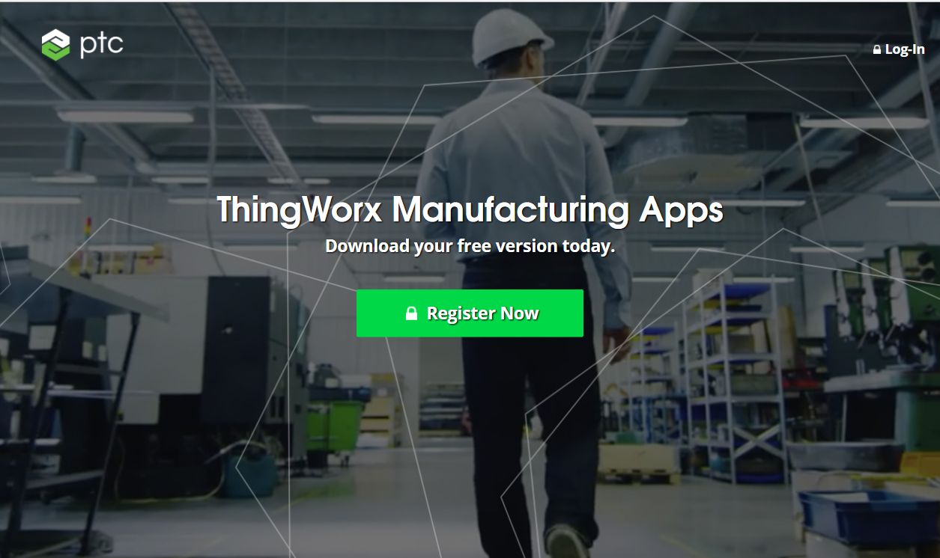
Access your free Thingworx Manufacturing Apps
Start your journey in under 60 minutes today!
http://bit.ly/Try-the-Apps
https://www.ptc.com/en/thingworx/manufacturing-apps

Slide 13
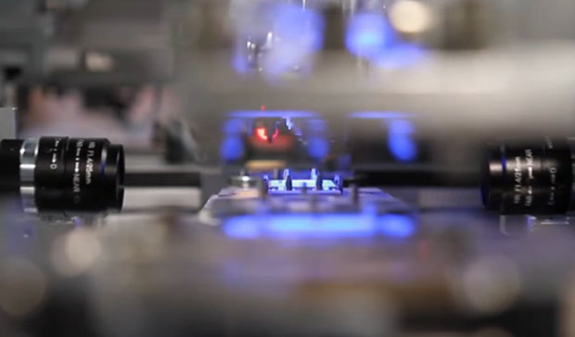











Continuously improve operational performance and flexibility through digital manufacturing, real-time intelligence and predictive analytics
OUTPERFORM
Synchronized Operations
Performance Benchmarking
Supplier
Visibility
Closed-Loop
Digital Thread
ADVANCE
AR Enabled
Operations
Digital
Processes
Predictive
Analytics
Agile
Innovation
ThingWorx Asset Advisor
ThingWorx Production Advisor
ThingWorx Controls Advisor
UNDERSTAND
Real-Time Issue
Identification
Unified
Connectivity
Role-Based Intelligence
TODAY
Digital Manufacturing
A Journey of Transformation
Notes:
Manufacturing Journey 2.0
1. Understand: Make decisions quickly by connecting and unifying different sources and structures of internal and external data in real-time
2. Advance: Streamline your operations and continuously innovate through predictive analytics, digital processes, and a guided workforce
3. Outperform: Achieve optimal execution through continuous, closed-loop process improvement and adaptive operations

Slide 14
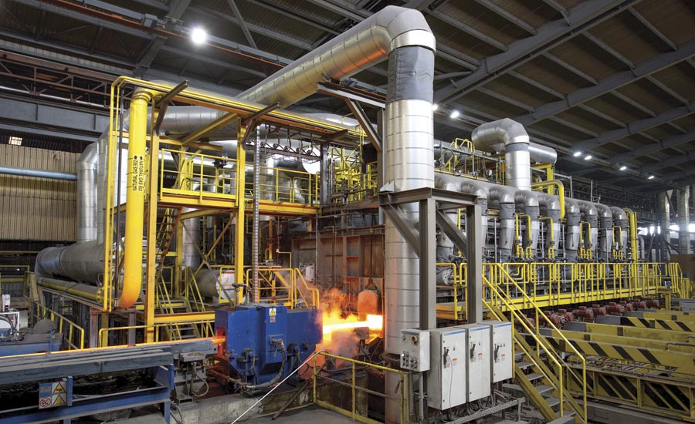
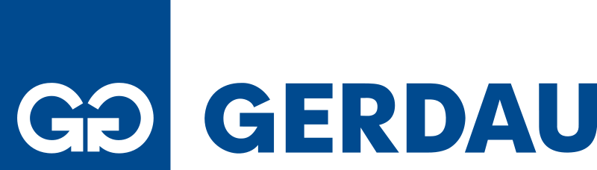
Gerdau – Manufacturing Starter Apps
“Within 10 minutes of downloading and configuring the apps I was already trending two of our signals – amazingly quick!”
– Jason Magill, IT Team Lead
Notes:
Gerdau, headquartered in Porto Alegre, the capital and largest city in the Brazilian state of Rio Grande do Sul, is the largest producer of long steel in the Americas, with steel mills in Brazil, Argentina, Canada, Chile, Colombia, Dominican Republic, Guatemala, India, Mexico, Peru, Spain, United States, Uruguay and Venezuela. It also holds a 40% stake in the Spanish company Sidenor. Currently, Gerdau has an installed capacity of 26 million metric tons of steel per year and offers steel for the civil construction, automobile, industrial, agricultural and various sectors.
Gerdau is the world’s 14th largest steelmaker and the largest producer of long steel in the Americas. It has 337 industrial and commercial units and more than 45,000 employees across 14 countries.

Slide 15
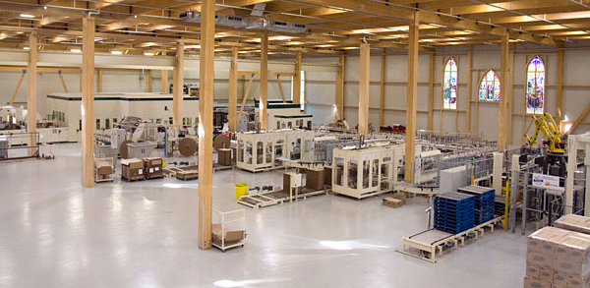

Cascades – Controls Advisor
“I will show the tool to my team and use it every time we have support calls regarding data collection.”
– Benoit Lapensee, Director of MES
Notes:
Founded in 1964, Cascades produces, converts and markets packaging and tissue products that are composed mainly of recycled fibers. The Company employs 11,000 employees, who work in close to 90 production units located in North America and Europe.
Cascades is Kepware customer, with over 30 installations of Kepware, monitoring 500+ machines globally.
Benoit and his team manage all of these servers, and BETA tested Kinex. Before Kinex Connectivity Insight, Benoit and his team didn’t find out about lost machine connectivity until someone from the plant called about the problem. Often this was days after the issue occurred, and valuable data had been lost. With Kinex Connectivity Insight, Benoit and his team are instantly notified of connectivity issues, and have the tools needed to resolve them.
As soon as Benoit installed Kinex Connectivity Insight he noticed a PLC at one of his remote sites was offline that he didn’t expect. He immediately called up the facility and resolved the issue.

Slide 16


