Slide 1

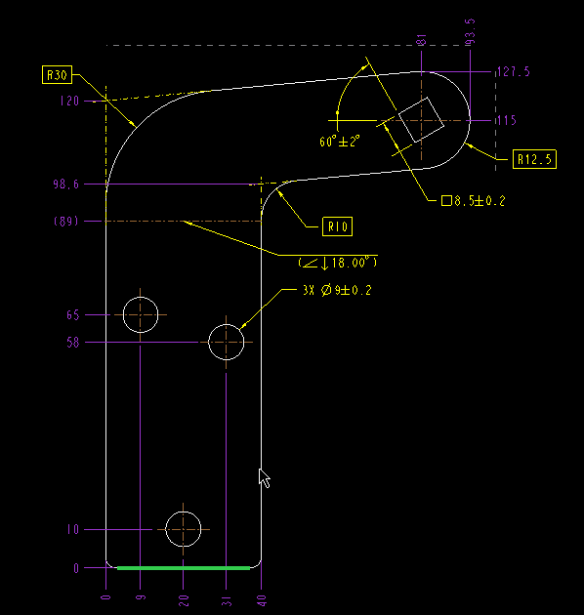
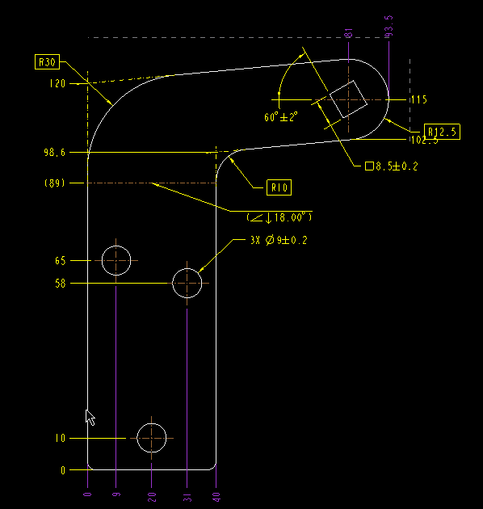

Tips & Tricks: ordinate dimension fails (turns purple)
Module : Drawing
Problem :
Sometime we are facing the problem while changing coordinates system dimension drawing ordinate
Dimension fails (turns purple) and we are unable to do “Edit attachment” to change the base ordinate dimension.
Root Cause :
We changed the origin surface or plane
Case Closure Details
Stepped to retrieve the failed base co-ordinate is to create dimension from original base reference to other end reference, select the new dimension, RMB click to &Toggle Ordinate/Linear and then select existing purple (magenta) color dimension text (od##). Next, Erase the newly created dimension and #Review > #Regenerate Active Model > #Update Sheets. This resolved the issue.
Drafter can save
the drawing
correction time

