Slide 1
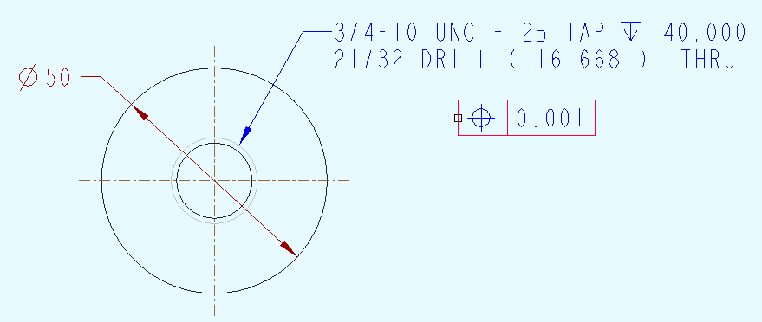
create gtol as a free note

Slide 2
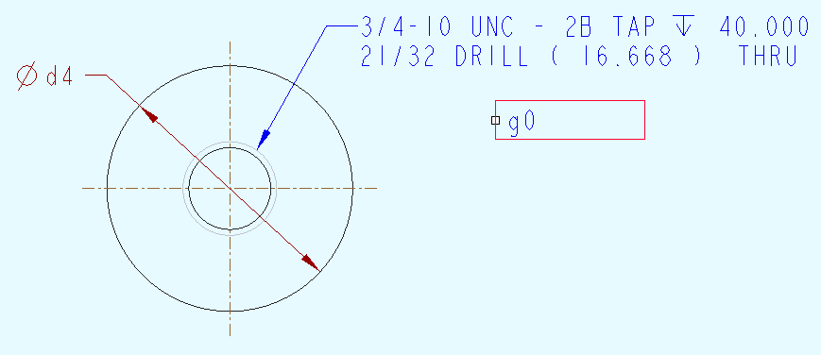
switch symbols to see the name of the gtol – here it’s g0

Slide 3
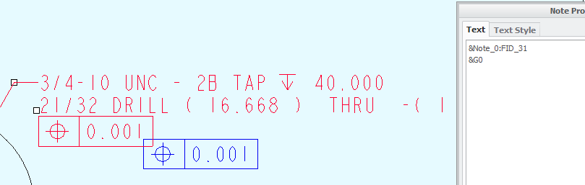
add the gtol to the note – “&g0”

Slide 4
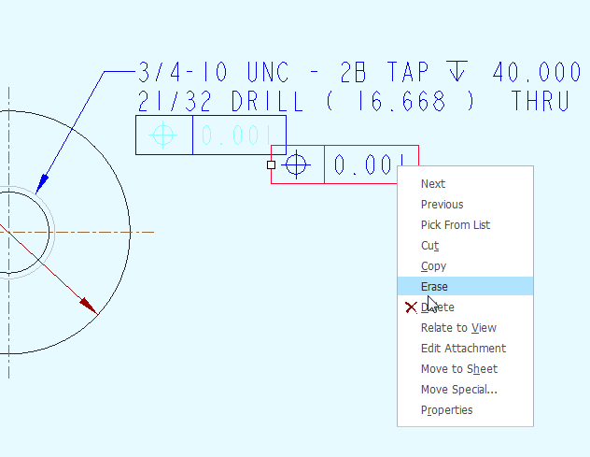
erase the original gtol

