Slide 1
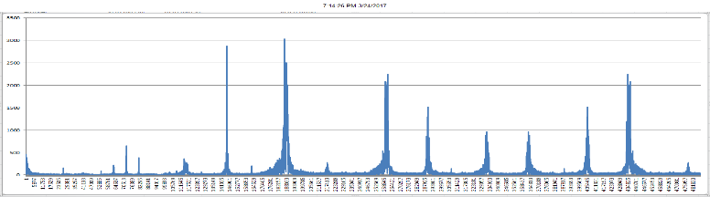
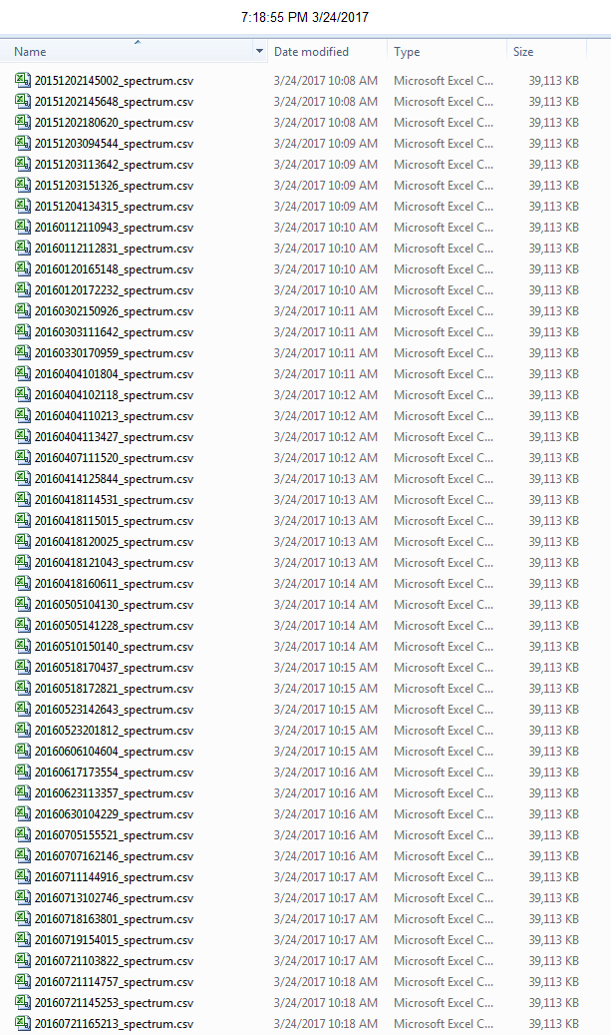


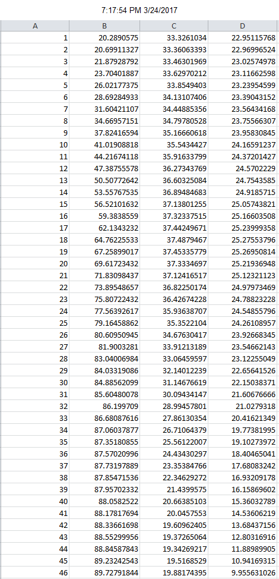
3
ThingWorx Mashup
1
Series of Spectrum Image Files
X Acce.
Frequency Spectrum
4
Y Acce.
Frequency Spectrum
Z Acce.
Frequency Spectrum
Spectrum Image File (.csv)
2
Freq AmplX AmplY AmplZ
Freq 1 = 1 Hz
Freq 2 = 2 Hz
Freq 3 = 3 Hz
…
Freq 50,000 = 50,000 Hz
Freq AmplX AmplY AmplZ
50,000 rows
(“rotate” table 90 degrees)

